Slide 1
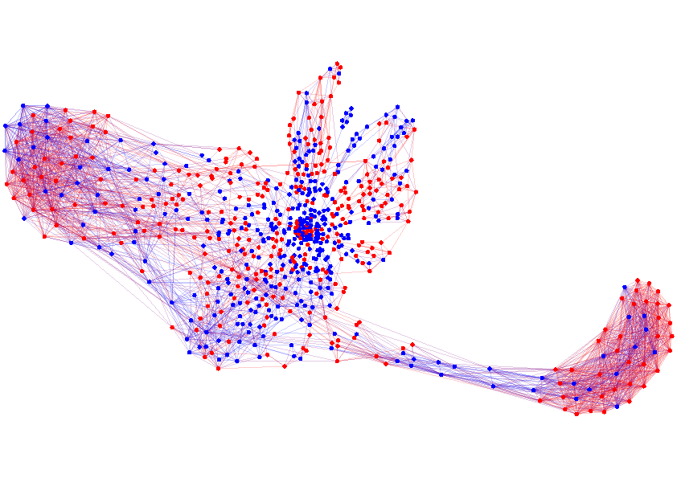
Manuel Gomez Rodriguez
Machine learning for
Dynamic Social Network Analysis
Max Planck Institute for Software Systems
UC3M, May 2017

Slide 2
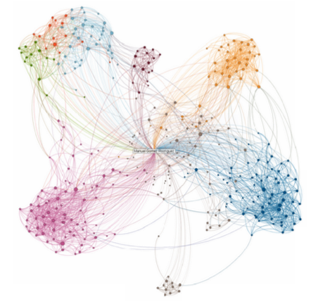
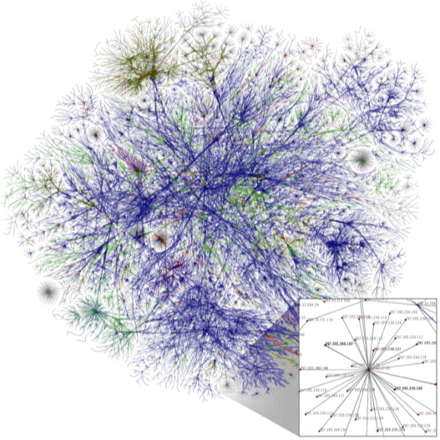
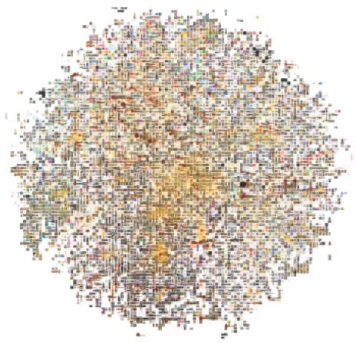
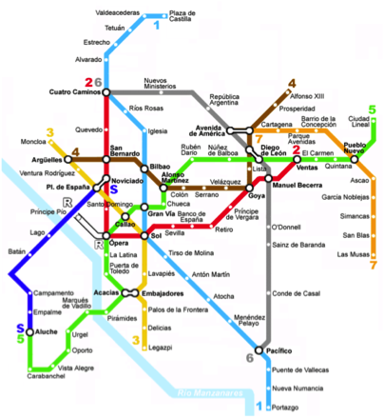
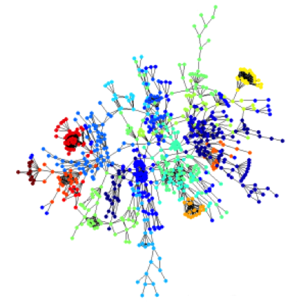
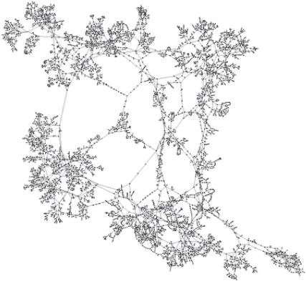
Interconnected World
  Social Networks
  World Wide Web
  Information Networks
  Transportation
  Networks
  Protein Interactions
  Internet of Things

Slide 3
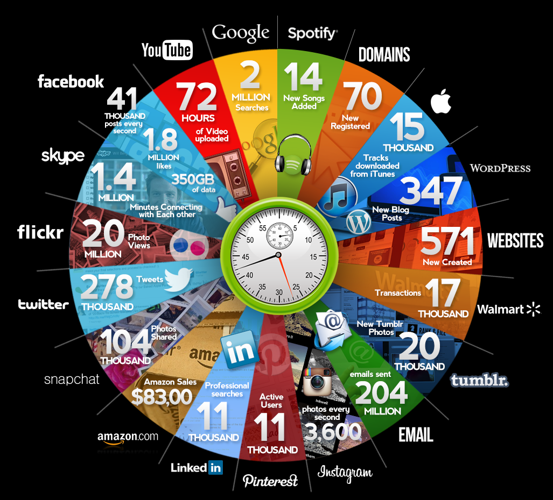
Many discrete events in continuous time
Qmee, 2013

Slide 4





Variety of processes behind these events
Events are (noisy) observations of a variety of complex dynamic processes…
  Product reviews and sales in Amazon
  News spread in Twitter
  A user gains recognition in Quora
  Video
  becomes viral
  in Youtube
  Article creation in Wikipedia
  Fast
  Slow
…in a wide range of temporal scales.

Slide 5
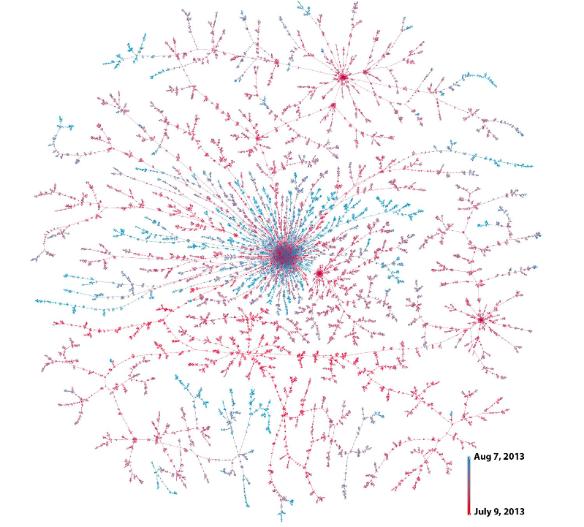





Example I: Idea adoption/viral marketing
S
D
means
Christine
D follows S
Bob
3.00pm
3.25pm
Beth
3.27pm
Joe
David
4.15pm
Friggeri et al., 2014
They can have an impact
in the off-line world

Slide 6

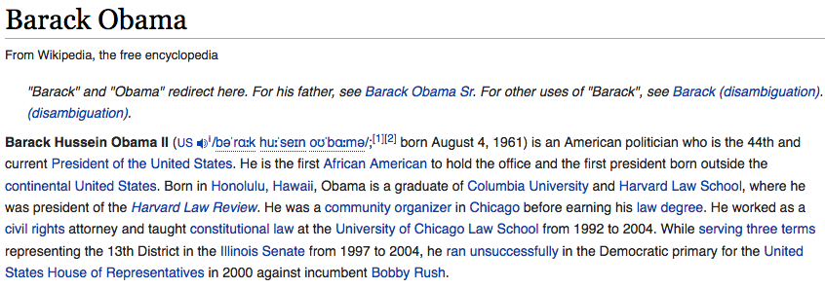

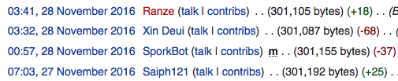





Example II: Information creation & curation
✗
Addition
Refutation
Question
Answer
Upvote

Slide 7

Example III: Learning trajectories
1st year computer science student
Introduction to programming
Discrete math
Project presentation
Graph Theory
Powerpoint
vs. Keynote
Class
inheritance
For/do-while
loops
Define
functions
Export
pptx to pdf
Set theory
Geometry
t
How to write
switch
Logic
Private
functions
PP
templates
If … else
Class
destructor
Plot
library

Slide 8

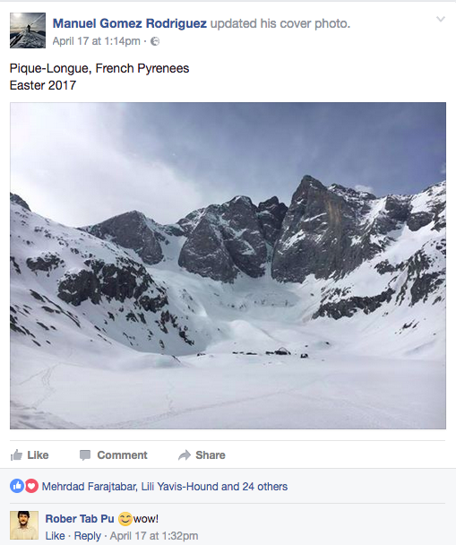
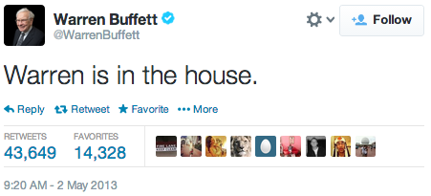



Detailed event traces
The availability of event traces boosts a new generation of
data-driven models and algorithms
Detailed Traces of Activity
t

Slide 9

Previously: discrete-time models & algorithms
Epoch 1
Epoch 2
Epoch 3
Epoch 4
Discrete-time models artificially introduce epochs:
1. How long is each epoch? Data is very heterogeneous.
2. How to aggregate events within an epoch?
3. What if no event within an epoch?
4. Time is treated as index or conditioning variable, not easy
to deal with time-related queries.

Slide 10
Outline of the Seminar
Representation: Temporal Point processes
1. Intensity function
2. Basic building blocks
3. Superposition
4. Marks and SDEs with jumps
This lecture
Applications: Models
1. Information propagation
2. Opinion dynamics
3. Information reliability
4. Knowledge acquisition
Applications: Control
1. Influence maximization
2. Activity shaping
3. When-to-post
Slides/references: learning.mpi-sws.org/uc3m-seminar
Notes:
Outline of tutorial

Slide 11
Representation:
Temporal Point Processes
1. Intensity function
2. Basic building blocks
3. Superposition
4. Marks and SDEs with jumps

Slide 12










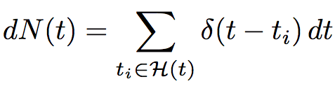
Temporal point processes
Temporal point process:
A random process whose realization consists of
discrete events localized in time
Discrete events
time
History,
Dirac delta function
Formally:

Slide 13








Model time as a random variable
density
Prob. between [t, t+dt)
time
History,
Prob. not before t
Likelihood of a timeline:

Slide 14
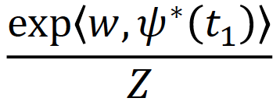
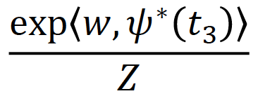
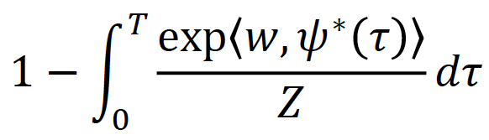
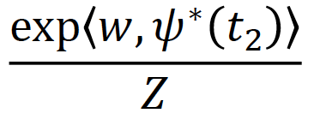
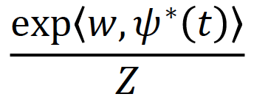
Problems of density parametrization (I)
time
It is difficult for model design and interpretability:
Densities need to integrate to 1 (i.e., partition function)
Difficult to combine timelines

Slide 15


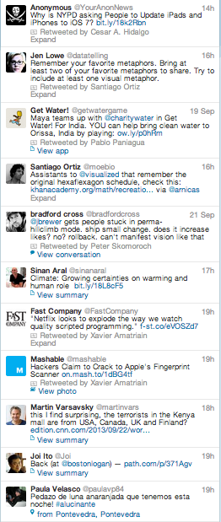

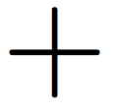

Problems of density parametrization (II)
Difficult to combine timelines:
time
+
time
=
✗
Sum of random processes
✗

Slide 16





Intensity function
density
Prob. between [t, t+dt)
time
History,
Prob. not before t
Intensity:
Probability between [t, t+dt) but not before t
Observation:
It is a rate = # of events / unit of time

Slide 17


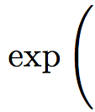
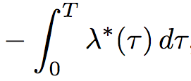


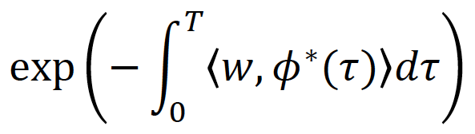


Advantages of intensity parametrization (I)
time
Suitable for model design and interpretable:
Intensities only need to be nonnegative
Easy to combine timelines

Slide 18
Advantages of intensity parametrization (II)
Easy to combine timeline:
time
+
time
=
Sum of random processes
✗

Slide 19





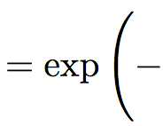
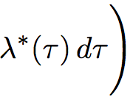

Relation between f*, F*, S*, λ*
Central quantity
we will use!

Slide 20
Representation:
Temporal Point Processes
1. Intensity function
2. Basic building blocks
3. Superposition
4. Marks and SDEs with jumps
Notes:
Outline of tutorial

Slide 21


Poisson process
time
Intensity of a Poisson process
Observations:
Intensity independent of history
Uniformly random occurrence
Time interval follows exponential distribution

Slide 22
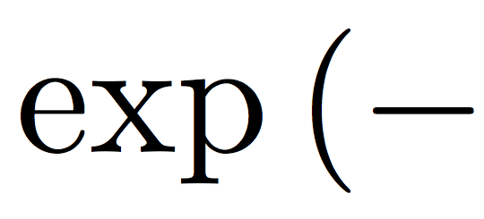




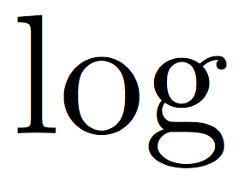


Fitting a Poisson from (historical) timeline
time
Maximum
likelihood

Slide 23






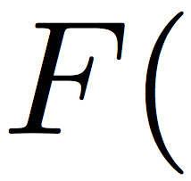

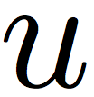


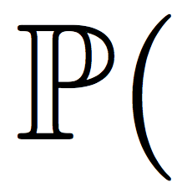


Sampling from a Poisson process
time
We would like to sample:
We sample using inversion sampling:

Slide 24

Inhomogeneous Poisson process
time
Intensity of an inhomogeneous Poisson process
Observations:
Intensity independent of history

Slide 25






Fitting an inhomogeneous Poisson
time
Maximum
likelihood
Design such that
max. likelihood is convex
(and use CVX)

Slide 26


Nonparametric inhomogeneous Poisson process
Positive combination of (Gaussian) RFB kernels:

Slide 27
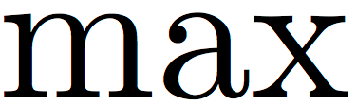


Sampling from an inhomogeneous Poisson
time
Thinning procedure (similar to rejection sampling):
Sample from Poisson process with intensity
Inversion
sampling
Generate
Keep sample with prob.
Keep the sample if

Slide 28

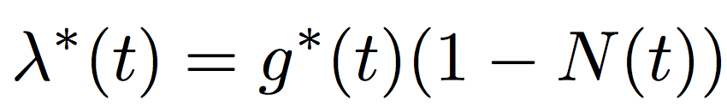

Terminating (or survival) process
time
Intensity of a terminating (or survival) process
Observations:
Try sampling and fitting!
Limited number of occurrences

Slide 29


Self-exciting (or Hawkes) process
time
History,
Triggering kernel
Intensity of self-exciting
(or Hawkes) process:
Observations:
Clustered (or bursty) occurrence of events
Intensity is stochastic and history dependent

Slide 30





Fitting a Hawkes process from a recorded timeline
time
Maximum
likelihood
The max. likelihood
is jointly convex
in and
(use CVX!)

Slide 31

Sampling from a Hawkes process
time
Thinning procedure (similar to rejection sampling):
Sample from Poisson process with intensity
Inversion
sampling
Generate
Keep sample with prob.
Keep the sample if

Slide 32
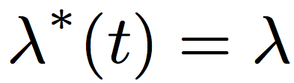

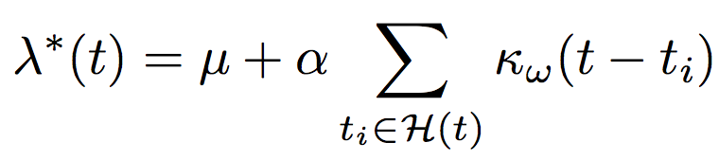
Summary
Building blocks to represent different dynamic processes:
Poisson processes:
We know how to fit them
and how to sample from them
Inhomogeneous Poisson processes:
Terminating point processes:
Self-exciting point processes:

Slide 33
Representation:
Temporal Point Processes
1. Intensity function
2. Basic building blocks
3. Superposition
4. Marks and SDEs with jumps
Notes:
Outline of tutorial

Slide 34


Superposition of processes
time
Sample each intensity + take minimum = Additive intensity

Slide 35



Mutually exciting process
Bob
time
History
Christine
time
History
Clustered occurrence affected by neighbors

Slide 36


Mutually exciting terminating process
Bob
time
Christine
time
History
Clustered occurrence affected by neighbors

Slide 37
Representation:
Temporal Point Processes
1. Intensity function
2. Basic building blocks
3. Superposition
4. Marks and SDEs with jumps
Notes:
Outline of tutorial

Slide 38


Marked temporal point processes
Marked temporal point process:
A random process whose realization consists of discrete marked events localized in time
time
time
History,

Slide 39


Independent identically distributed marks
time
Distribution for the marks:
Observations:
Marks independent of the temporal dynamics
Independent identically distributed (I.I.D.)

Slide 40


Dependent marks: SDEs with jumps
time
History,
Marks given by stochastic differential equation with jumps:
Observations:
Drift
Event influence
Marks dependent of the temporal dynamics
Defined for all values of t

Slide 41

Dependent marks: distribution + SDE with jumps
time
History,
Distribution for the marks:
Observations:
Drift
Event influence
Marks dependent on the temporal dynamics
Distribution represents additional source of uncertainty

Slide 42


Mutually exciting + marks
Bob
time
Christine
Marks affected by neighbors
Drift
Neighbor influence

Slide 43
Representation: Temporal Point processes
1. Intensity function
2. Basic building blocks
3. Superposition
4. Marks and SDEs with jumps
This lecture
Applications: Models
1. Information propagation
2. Opinion dynamics
3. Information reliability
4. Knowledge acquisition
Next lecture
Applications: Control
1. Influence maximization
2. Activity shaping
3. When-to-post
Slides/references: learning.mpi-sws.org/sydney-seminar
Notes:
Outline of tutorial

