Slide 1
Learning with
Temporal Point Processes
Models & Inference
Isabel Valera
Max Planck Institute for Intelligent Systems
ICML Tutorial, July 2018

Slide 2
Models & Inference
1. Modeling event sequences
2. Clustering event sequences
3. Capturing complex dynamics
4. Causal reasoning on event sequences
Notes:
Outline of tutorial

Slide 3
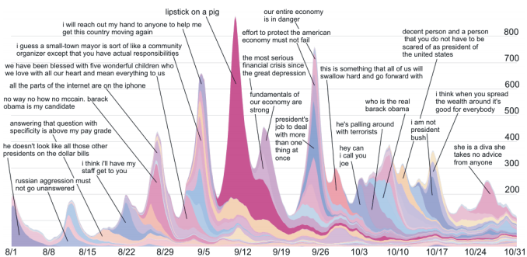


Event sequences as cascades
S
D
Information Diffusion
means
Christine
D follows S
Bob
3.00pm
3.25pm
Beth
3.27pm
Joe
David
[Leskovec et al., 2009]
4.15pm
Disease Diffusion
Event:
Time
User
[Rizoiu et al., 2018]

Slide 4
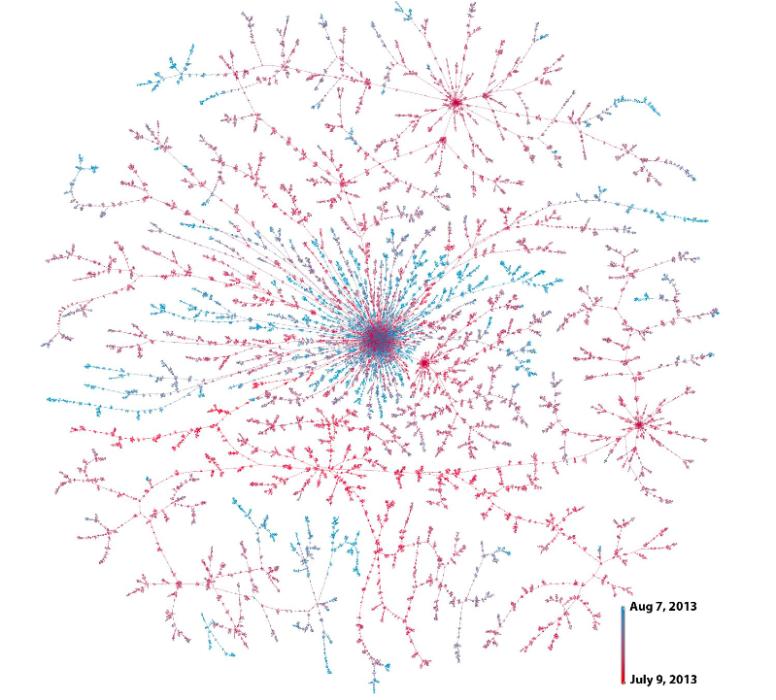



An example: idea adoption
S
D
means
Christine
D follows S
Bob
3.00pm
3.25pm
Beth
3.27pm
Joe
David
4.15pm
Friggeri et al., 2014
They can have an impact
in the off-line world

Slide 5

Infection cascade representation
We represent an infection cascade using terminating temporal point processes:
N₁(t)
Infection event:
N₂(t)
N₃(t)
User
Time
Cascade
N₄(t)
N₅(t)

Slide 6

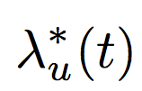

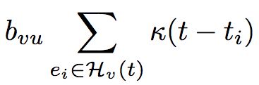



Infection intensity
Source
(given, not modeled)
N₁(t)
N₂(t)
Follow-ups
(modeled)
N₃(t)
N₄(t)
N₅(t)
Memory
Users get infected only once
Influence from
user v on user u
Previous
infections of user v
[Gomez-Rodriguez et al., ICML 2011]

Slide 7
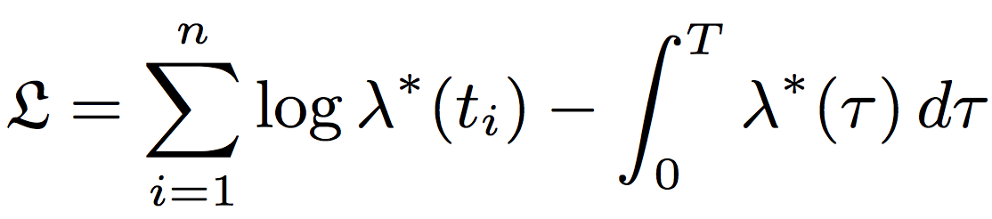
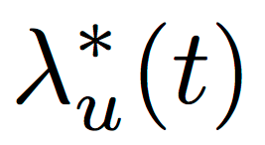


Model inference from multiple cascades
Conditional intensities
Diffusion log-likelihood
Maximum likelihood approach to find
model parameters!
Sum up log-likelihoods
of multiple cascades!
Theorem. For any choice of parametric memory, the maximum likelihood problem is convex in B.
[Gomez-Rodriguez et al., ICML 2011]

Slide 8
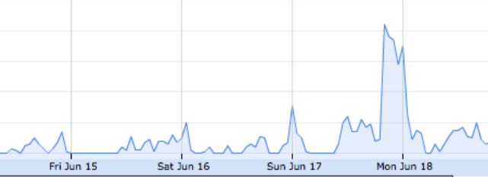
Dynamic influence
In some cases, influence change over time:
#greece
retweets
0
T
Propagation over networks
with variable influence
[Gomez-Rodriguez et al., WSDM 2013]

Slide 9


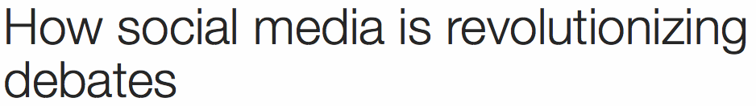

Recurrent events: beyond cascades
Christine
Up to this point, each users is only infected once, and event sequences can be seen as cascades.
Bob
Beth
Joe
In general, users perform recurrent
events over time. E.g., people repeatedly
express their opinion online:
David

Slide 10

Recurrent events representation
We represent messages using nonterminating temporal point processes:
N₁(t)
Recurrent event:
N₂(t)
N₃(t)
User
Time
N₄(t)
N₅(t)
[Farajtabar et al., NIPS 2014]

Slide 11


Recurrent events intensity
N₁(t)
N₂(t)
N₃(t)
N₄(t)
N₅(t)
Memory
Cascade sources!
Hawkes process
User’s
intensity
Events on her
own initiative
Previous
messages by user v
Influence from
user v on user u
[De et al., NIPS 2016]

Slide 12
Models & Inference
1. Modeling event sequences
2. Clustering event sequences
3. Capturing complex dynamics
4. Causal reasoning on event sequences
Notes:
Outline of tutorial

Slide 13
Event sequences
So far, we have assumed the cascade (topic, meme, etc.) that each event belongs to was known.
Often, the cluster (topic, meme, etc.) that each event in a sequence belongs to is not known:
Politics
Music

Slide 14
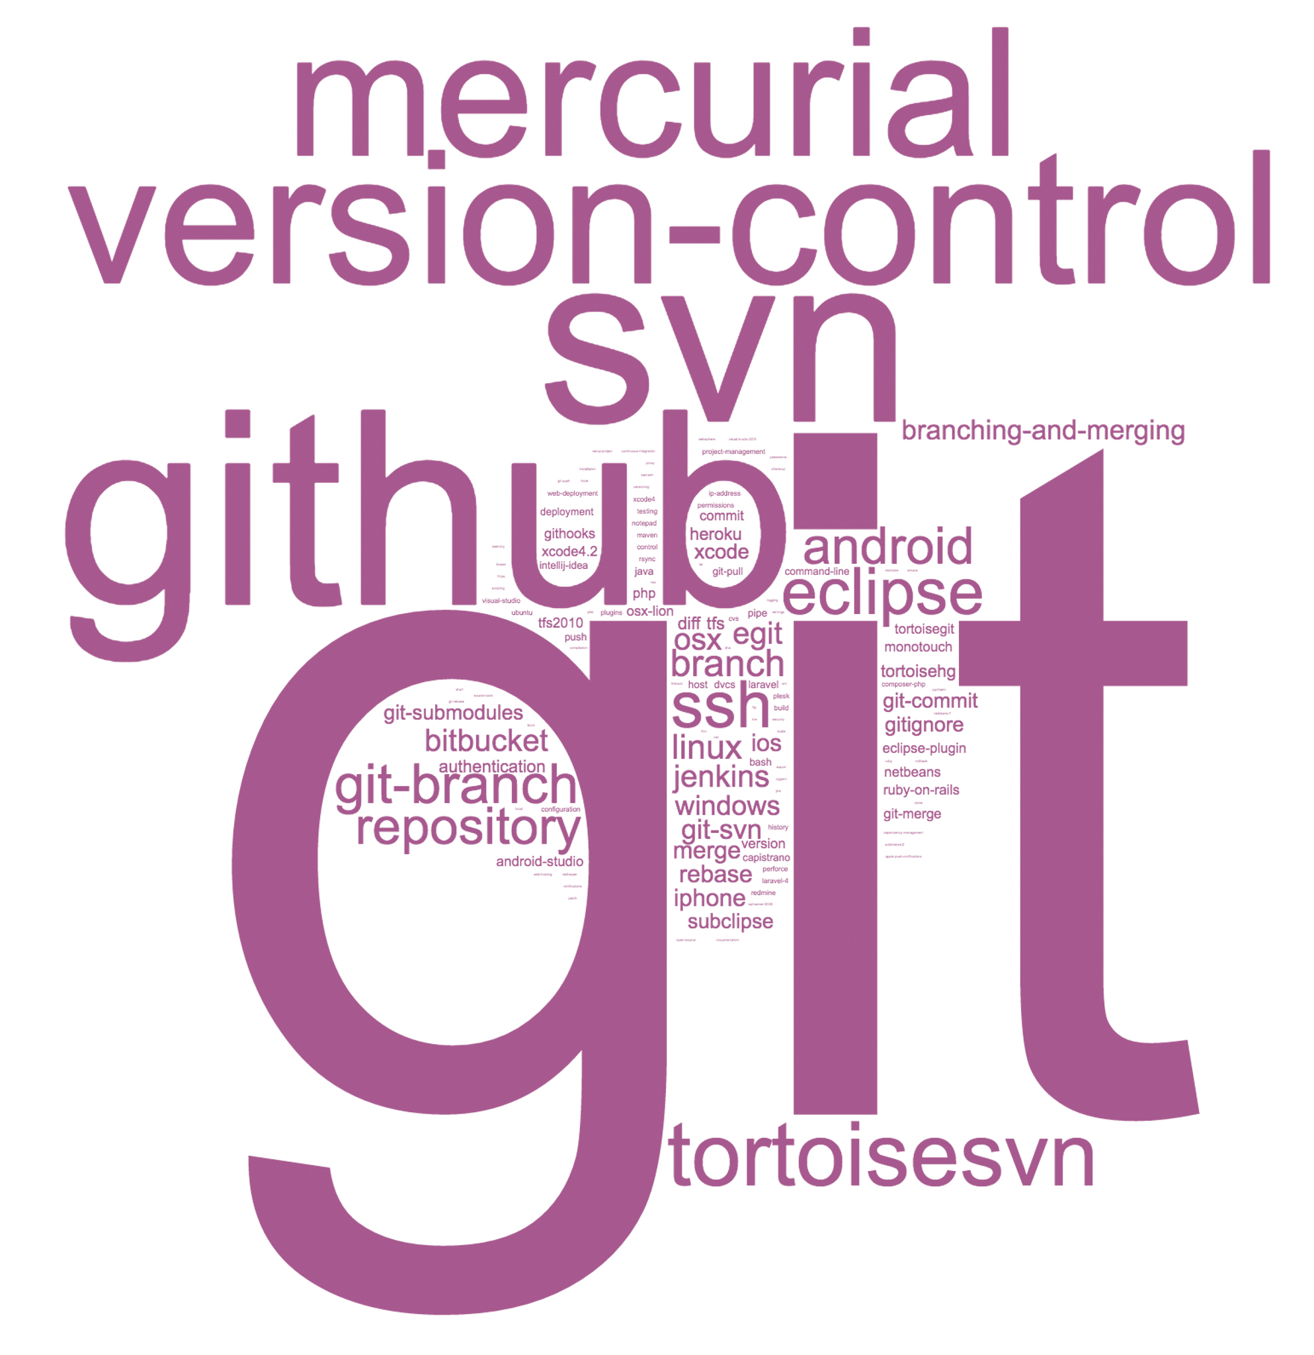
Clustering event sequences
Assume the event cluster to be hidden and aim to automatically learn the cluster assigments from the data:
t
t
Bayesian methods to cluster event sequences in the context of:
Online News
Health care
Learning
[Du et al., 2015; Mavroforakis et al., 2017; Xu & Zha, 2017]

Slide 15

Hierarchical Dirichlet Hawkes process
1st year computer science student
Introduction to programming
Discrete math
Project presentation
Graph Theory
Powerpoint
vs. Keynote
Class
inheritance
For/do-while
loops
Define
functions
Export
pptx to pdf
Set theory
Geometry
t
How to write
switch
Logic
Private
functions
PP
templates
If … else
Plot
library
Class
destructor
[Mavroforakis et al., WWW 2017]

Slide 16
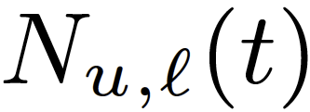
Events representation
We represent the events using marked temporal point processes:
Task
Task
Event:
Time
Content
Cluster
(hidden)
[Mavroforakis et al., WWW 2017]

Slide 17
Cluster intensity
Task
Task
Memory
New cascade
rate
Cluster
popularity
Hawkes process
Intensity
or rate
(events / hour)
Own
initiative
Follow-up
[Mavroforakis et al., WWW 2017]

Slide 18



User events intensity
Users adopt more than one cluster:
t
t
A user’s learning events as a multidimensional Hawkes:
Time
cluster
Content
[Mavroforakis et al., WWW 2017]

Slide 19
People share same clusters
Different users adopt same clusters
Efficient model inference using Sequential Montecarlo!
t
t
Details in the reference below!
Cluster distribution from a Dirichlet process:
Infinite # of clusters.
Shared parameters across users.
[Mavroforakis et al., WWW 2017]

Slide 20

Learning cluster (I): Version Control
Content
Intensities
Intensity
Version control tasks tend to be specific, quickly solved after performing few questions
[Mavroforakis et al., WWW 2017]

Slide 21
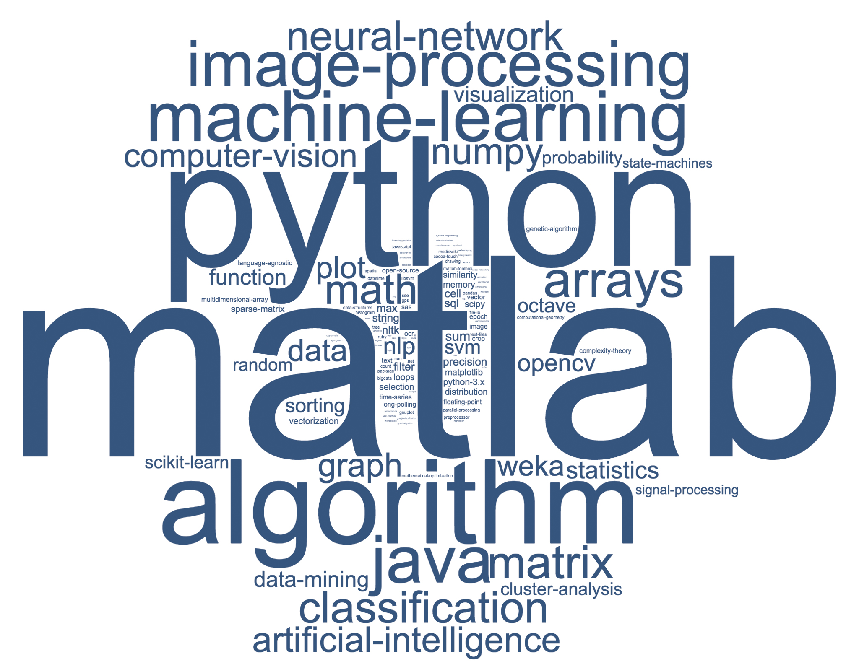
Learning cluster (II): Machine learning
Content
Intensities
Machine learning tasks tend to be more complex and require asking more questions
[Mavroforakis et al., WWW 2017]

Slide 22
Models & Inference
1. Modeling event sequences
2. Clustering event sequences
3. Capturing complex dynamics
4. Causal reasoning on event sequences
Notes:
Outline of tutorial

Slide 23







Towards real-world temporal dynamics
Up to now, we have focused on simple temporal dynamics (and intensity functions):
Recent works make use of RNNs to capture more complex dynamics
[Du et al., 2016; Dai et al., 2016; Mei & Eisner, 2017; Jing & Smola, 2017; Trivedi et al., 2017; Xiao et al., 2017a; 2018]

Slide 24
Neural Hawkes process
History effect does not need to be additive
2) Allows for complex memory effects
(such as delays)
[Mei & Eisner, NIPS 2017]

Slide 25
Neural Hawkes process
Memory
Parameter learning using stochastic gradient descent
Excitation & inhibition
Details in the reference below!
[Mei & Eisner, NIPS 2017]

Slide 26
Applications (I): Predictive Models
Know-Evolve, Trivedi et al. (2017)
Coevolutionary Embedding,
Dai et al. (2017)
Neural Survival Recommender, Jing & Smola (2017)

Slide 27
Applications (II): Generative Models
Key idea: Intensity- and likelihood-free models
Wasserstein-Distance for
Temporal Point Processes
GAN architecture
[Xiao et al., 2017 & 2018]

Slide 28
Models & Inference
1. Modeling event sequences
2. Clustering event sequences
3. Capturing complex dynamics
4. Causal reasoning on event sequences
Notes:
Outline of tutorial

Slide 29


Temporal point processes beyond prediction
So far, we have focused on models that improve preditions:
Recommendations
Community
detection
Link prediction
[Trivedi et al., 2017]
[Xiao et al., 2017]
[Dai et al., 2017]
Recent works have focused on performing causal inference using event sequences:
Treatment effect
Granger causality graph
[Xu et al., 2016; Achab et al., 2017; Kuśmierczyk & Gomez-Rodriguez, 2018]

Slide 30
Uncovering Causality from Hawkes Processes
Multivariate Hawkes process:
Effect of v‘s past events on u
Granger causality:
“X causes Y in the sense of Granger causality if forecasting future values of Y is more successful while taking X past values into account"
[Granger, 1969]
[Achab et al., ICML 2017]

Slide 31
Uncovering Causality from Hawkes Processes
Multivariate Hawkes process:
Effect of v‘s past events on u
Granger causality on multivariate Hawkes processes:
“ does not Ganger-cause w.r.t. if and only if
for "
[Eichler et al., 2016]
[Achab et al., ICML 2017]

Slide 32
Uncovering Causality from Hawkes Processes
Goal is to estimate , where:
Average total # of events of node u whose direct ancestor is an event by node v
Then, quantifies the direct causal relationship
between nodes.
[Achab et al., ICML 2017]

Slide 33
Uncovering Causality from Hawkes Processes
Goal is to estimate , where:
Average total # of events of node u whose direct ancestor is an event by node v
Then, quantifies the direct causal relationship
between nodes.
Key idea: Estimate G using the cumulants dN(t) of the Hawkes process.
[Achab et al., ICML 2017]

Slide 34
Uncovering Causality from Hawkes Processes
Goal is to estimate , where:
Non parametric Hawkes cumulant estimation method
(with TensorFlow implementation)
Average total # of events of node u whose direct ancestor is an event by node v
Then, quantifies the direct causal relationship
between nodes.
Details in the reference below!
Key idea: Estimate G using the cumulants the dN(t) of the Hawkes process.
[Achab et al., ICML 2017]

Slide 35
Causal reasoning: Applications
Infectivity matrix estimation
Effect of Badges
[Xu et al., 2016]
[Kuśmierczyk & Gomez-Rodriguez, 2018]

Slide 36
Outline of the Seminar
Temporal Point processes (TPPs): Intro
1. Intensity function
2. Basic building blocks
3. Superposition
4. Marks and SDEs with jumps
Models & Inference
1. Modeling event sequences
2. Clustering event sequences
3. Capturing complex dynamics
4. Causal reasoning on event sequences
This
section
RL & Control
1. Marked TPPs: a new setting
2. Stochastic optimal control
3. Reinforcement learning
Next
section
Slides/references: learning.mpi-sws.org/tpp-icml18
Notes:
Outline of tutorial

