Slide 1
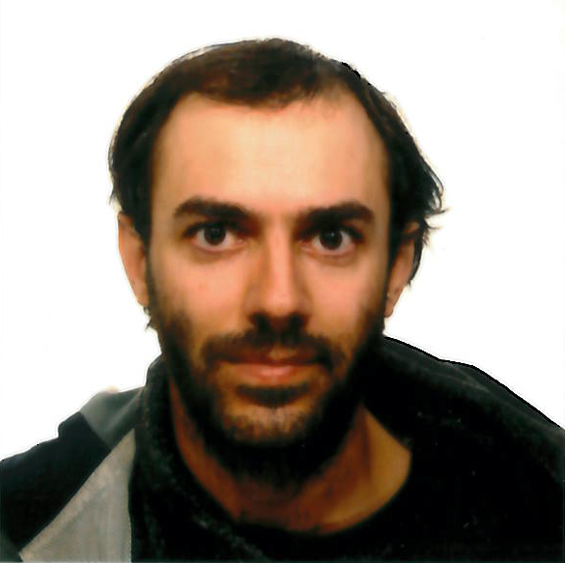
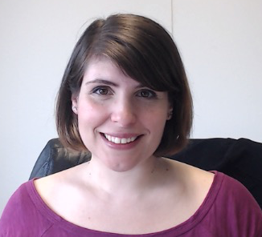
Manuel Gomez Rodriguez
Learning with
Temporal Point Processes
Isabel Valera
MPI for Software Systems
MPI for Intelligent Systems
Slides/references: http://learning.mpi-sws.org/tpp-icml18
ICML Tutorial, July 2018

Slide 2
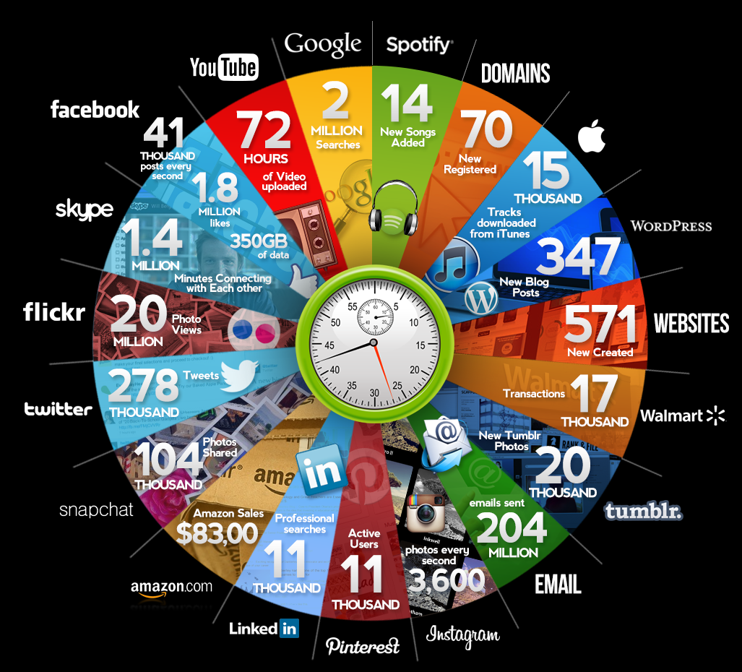
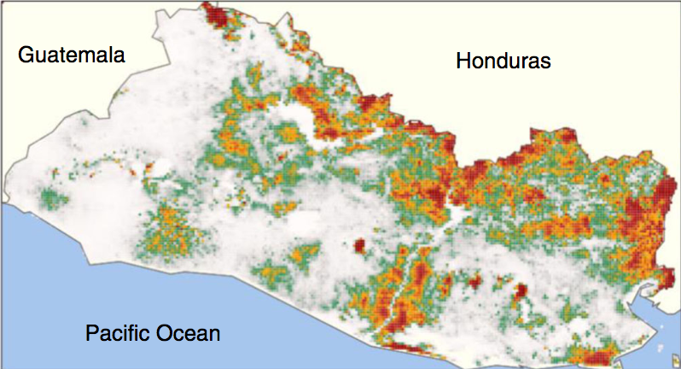
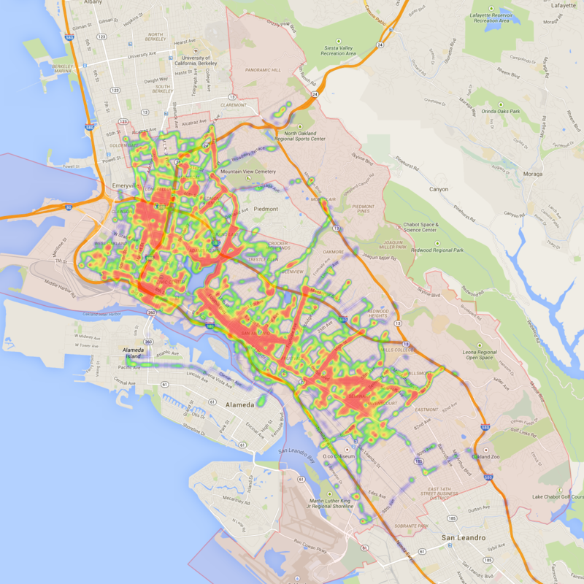

Many discrete events in continuous time
Disease dynamics
Qmee, 2013
Online actions
Financial trading
Mobility dynamics

Slide 3







Variety of processes behind these events
Events are (noisy) observations of a variety of complex dynamic processes…
  Stock
  trading
  Article creation in Wikipedia
  Flu
  spreading
  News spread in Twitter
  Reviews and sales in Amazon
  Ride-sharing requests
  A user’s reputation in Quora
  Fast
  Slow
…in a wide range of temporal scales.

Slide 4
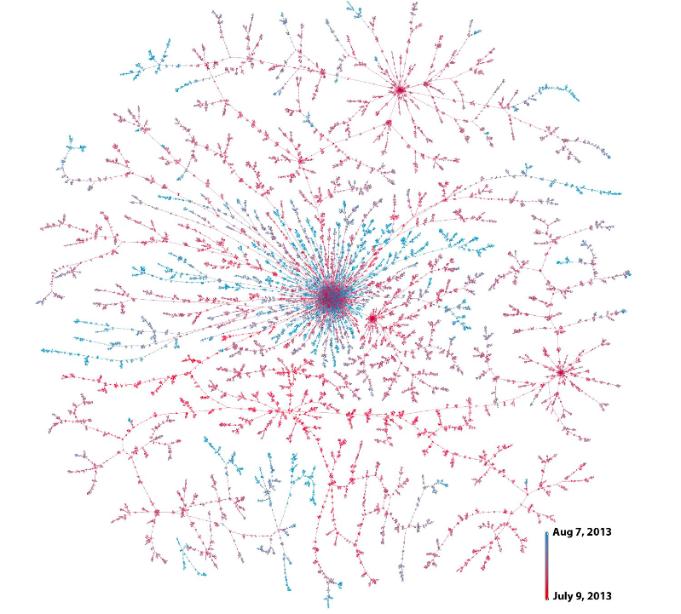





Example I: Information propagation
S
D
means
Christine
D follows S
Bob
3.00pm
3.25pm
Beth
3.27pm
Joe
David
4.15pm
Friggeri et al., 2014
They can have an impact
in the off-line world

Slide 5

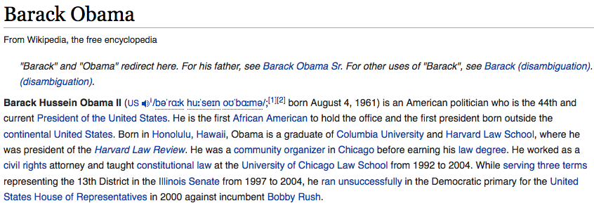

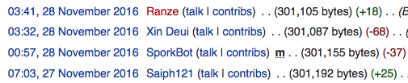





Example II: Knowledge creation
✗
Addition
Refutation
Question
Answer
Upvote

Slide 6

Example III: Human learning
1st year computer science student
Introduction to programming
Discrete math
Project presentation
Graph Theory
Powerpoint
vs. Keynote
Class
inheritance
For/do-while
loops
Define
functions
Export
pptx to pdf
Set theory
Geometry
t
How to write
switch
Logic
Private
functions
PP
templates
If … else
Class
destructor
Plot
library

Slide 7
Aren’t these event traces just time series?
The framework of
temporal point processes
provides a native representation
Discrete and continuous
times series
Discrete events in
continuous time
How long is each epoch?
What about aggregating events in epochs?
How to aggregate events per epoch?
What if no event in one epoch?
What about time-related queries?
Epoch 1
Epoch 2
Epoch 3

Slide 8
Outline of the Seminar
Temporal Point processes (TPPs): Intro
1. Intensity function
2. Basic building blocks
3. Superposition
4. Marks and SDEs with jumps
Next
Models & Inference
1. Modeling event sequences
2. Clustering event sequences
3. Capturing complex dynamics
4. Causal reasoning on event sequences
RL & Control
1. Marked TPPs: a new setting
2. Stochastic optimal control
3. Reinforcement learning
Slides/references: learning.mpi-sws.org/tpp-icml18
Notes:
Outline of tutorial

Slide 9
Temporal Point Processes (TPPs):
Introduction
1. Intensity function
2. Basic building blocks
3. Superposition
4. Marks and SDEs with jumps

Slide 10












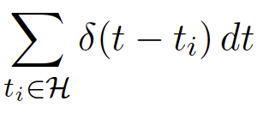
Temporal point processes
Temporal point process:
A random process whose realization consists of
discrete events localized in time
Discrete events
time
History,
Dirac delta function
Formally:

Slide 11








Model time as a random variable
density
Prob. between [t, t+dt)
time
History,
Prob. not before t
Likelihood of a timeline:

Slide 12
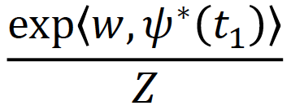
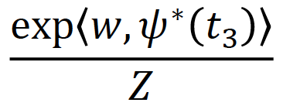
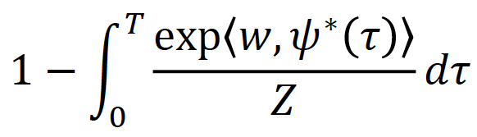
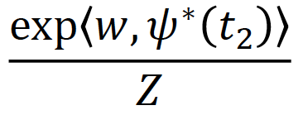
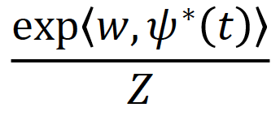
Problems of density parametrization (I)
time
It is difficult for model design and interpretability:
Densities need to integrate to 1 (i.e., partition function)
Difficult to combine timelines

Slide 13





Intensity function
density
Prob. between [t, t+dt)
time
History,
Prob. not before t
Intensity:
Probability between [t, t+dt) but not before t
Observation:
It is a rate = # of events / unit of time

Slide 14


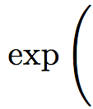
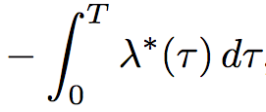


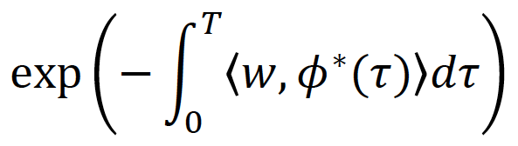


Advantages of intensity parametrization (I)
time
Suitable for model design and interpretable:
Intensities only need to be nonnegative
Easy to combine timelines

Slide 15





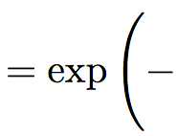
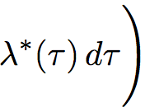

Relation between f*, F*, S*, λ*
Central quantity
we will use!

Slide 16
Representation:
Temporal Point Processes
1. Intensity function
2. Basic building blocks
3. Superposition
4. Marks and SDEs with jumps
Notes:
Outline of tutorial

Slide 17


Poisson process
time
Intensity of a Poisson process
Observations:
Intensity independent of history
Uniformly random occurrence
Time interval follows exponential distribution

Slide 18



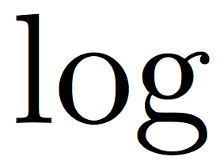










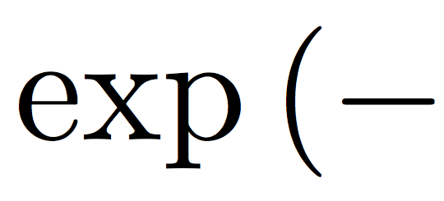






Fitting & sampling from a Poisson
time
Fitting by maximum likelihood:
Sampling using inversion sampling:

Slide 19



Inhomogeneous Poisson process
time
Intensity of an inhomogeneous Poisson process
(Independent of history)
Example:

Slide 20







Fitting & sampling from inhomogeneous Poisson
time
Fitting by maximum likelihood:
Sampling using thinning (reject. sampling) + inverse sampling:
Sample from Poisson process with intensity
using inverse sampling
Generate
Keep sample with prob.
Keep the sample if

Slide 21

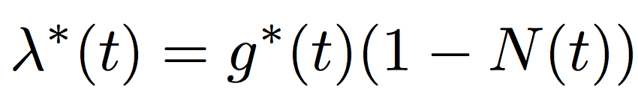

Terminating (or survival) process
time
Intensity of a terminating (or survival) process
Observations:
Try sampling and fitting!
Limited number of occurrences

Slide 22


Self-exciting (or Hawkes) process
time
History,
Triggering kernel
Intensity of self-exciting
(or Hawkes) process:
Observations:
Clustered (or bursty) occurrence of events
Intensity is stochastic and history dependent

Slide 23





Fitting a Hawkes process from a recorded timeline
time
Fitting by maximum likelihood:
The max. likelihood
is jointly convex
in and
Sampling using thinning (reject. sampling) + inverse sampling:
Key idea: the maximum of the intensity changes
over time

Slide 24
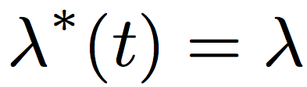

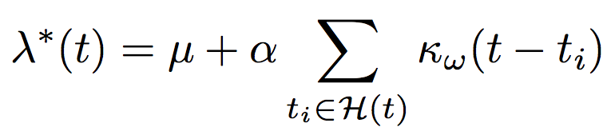
Summary
Building blocks to represent different dynamic processes:
Poisson processes:
We know how to fit them
and how to sample from them
Inhomogeneous Poisson processes:
Terminating point processes:
Self-exciting point processes:

Slide 25
Representation:
Temporal Point Processes
1. Intensity function
2. Basic building blocks
3. Superposition
4. Marks and SDEs with jumps
Notes:
Outline of tutorial

Slide 26



Mutually exciting process
Bob
time
History
Christine
time
History
Clustered occurrence affected by neighbors

Slide 27


Mutually exciting terminating process
Bob
time
Christine
time
History
Clustered occurrence affected by neighbors

Slide 28
Representation:
Temporal Point Processes
1. Intensity function
2. Basic building blocks
3. Superposition
4. Marks and SDEs with jumps
Notes:
Outline of tutorial

Slide 29


Marked temporal point processes
Marked temporal point process:
A random process whose realization consists of discrete marked events localized in time
time
time
History,

Slide 30


Independent identically distributed marks
time
Distribution for the marks:
Observations:
Marks independent of the temporal dynamics
Independent identically distributed (I.I.D.)

Slide 31


Dependent marks: SDEs with jumps
time
History,
Marks given by stochastic differential equation with jumps:
Observations:
Drift
Event influence
Marks dependent of the temporal dynamics
Defined for all values of t

Slide 32

Dependent marks: distribution + SDE with jumps
time
History,
Distribution for the marks:
Observations:
Drift
Event influence
Marks dependent on the temporal dynamics
Distribution represents additional source of uncertainty

Slide 33


Mutually exciting + marks
Bob
time
Christine
Marks affected by neighbors
Drift
Neighbor influence

Slide 34


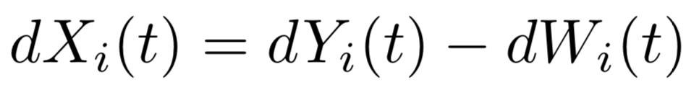










Marked TPPs as stochastic dynamical systems
Example:
Susceptible-Infected-Susceptible (SIS)
SDE with jumps
Susceptible
Infected
Susceptible
It gets infected
It recovers
Node is susceptible
Infection
rate
If friends are infected, higher infection rate
SDE with jumps
Recovery
rate
Self-recovery rate when node gets infected
If node recovers,
rate to zero
Rate increases if
node gets treated

Slide 35
Outline of the Seminar
Temporal Point processes (TPPs): Intro
1. Intensity function
2. Basic building blocks
3. Superposition
4. Marks and SDEs with jumps
This
section
Models & Inference
1. Modeling event sequences
2. Clustering event sequences
3. Capturing complex dynamics
4. Causal reasoning on event sequences
Next
section
RL & Control
1. Marked TPPs: a new setting
2. Stochastic optimal control
3. Reinforcement learning
Slides/references: learning.mpi-sws.org/tpp-icml18
Notes:
Outline of tutorial

