Slide 1
Diffusion in Social and Information Networks
Part II
learning.mpi-sws.org/kdd-2015-tutorial/
Le Song
Manuel Gomez Rodriguez
MPI for Software Systems
Georgia Institute of Technology
KDD 2015
Sydney

Slide 2
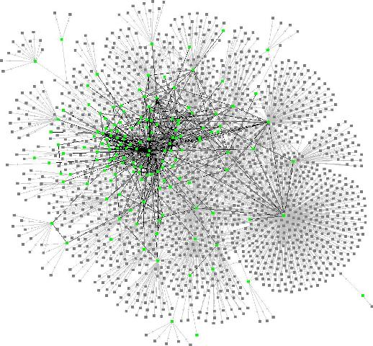
What is all about?
Stochastic processes
over a
large networks
Part I: Models
Part II: Learning Methods
  Modeling Information Diffusion
  Influence Maximization
Submodular Optimization
Scalable Algorithm
Basic Cascade Model
Cascades as Point Processes
  Source Localization
  Modeling Social
  Activity
Maximum likelihood
Estimation
  Activity Shaping
Beyond Cascades
Activity as Hawkes Processes
Beyond Influence Max
Convex Opt. Framework
Notes:
Outline of tutorial

Slide 3
Outline
  Influence Maximization
Exact & Approx. Estimation
Approx. Maximization
  Source Localization
Maximum likelihood
Estimation
  Activity Shaping
Beyond Influence Max
Convex Opt. Framework

Slide 4



Time-sensitive decision making
Can we seed information in a few sites, such that it can spread, in 1 month, to a million blogs?
Need to consider timing information
Need to be scalable

Slide 5

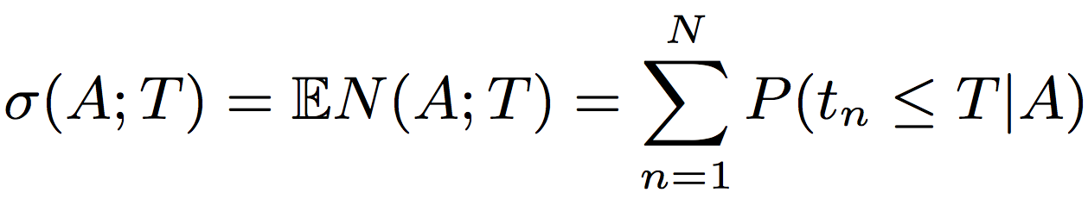
Influence of a set of sources
The influence is the average # of nodes infected up to time T by cascades that started in a set of sources nodes A. (icml’11)
# of nodes infected up to time T by a cascade that started in A
Probability of infection of node n given the source set A
t_{n}
t_{A} = 0
Source
t_{A} = 0
Sink (node n)

Slide 6
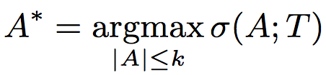
Maximizing the influence
Once we know how to estimate influence, what about finding the set of source nodes that maximizes influence?
Theorem. The continuous time influence maximization problem defined by Eq. (1)
is NP-hard.

Slide 7
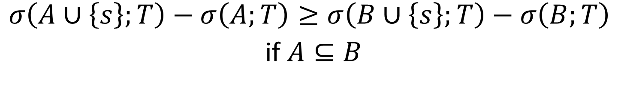
Submodularity of Influence Maximization
The influence function satisfies a natural diminishing property: submodularity!
$$σ\left(A∪\left\{s\right\};T\right)−σ\left(A;T\right)≥σ\left(B∪\left\{s\right\};T\right)−σ\left(B;T\right)$$
if $A⊆B$
The influence maximization can be reduced to a Set Cover problem

Slide 8

Submodular maximization
Theorem. The influence function is a submodular function in the set of nodes A.
Obtain a suboptimal solution with a 63% provable guarantee using the greedy algorithm:

Slide 9
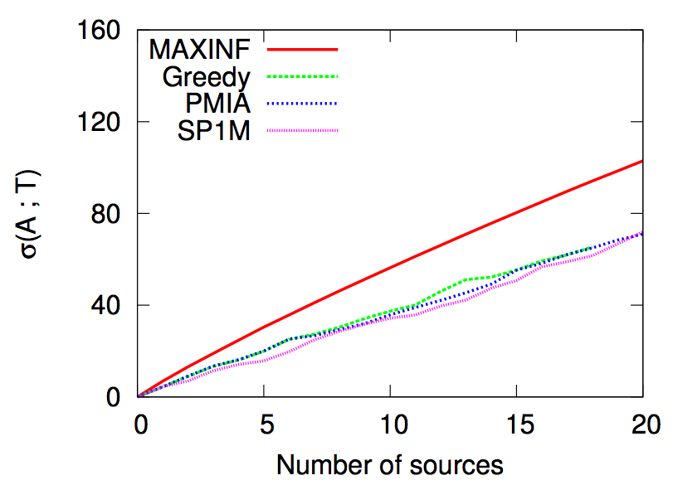
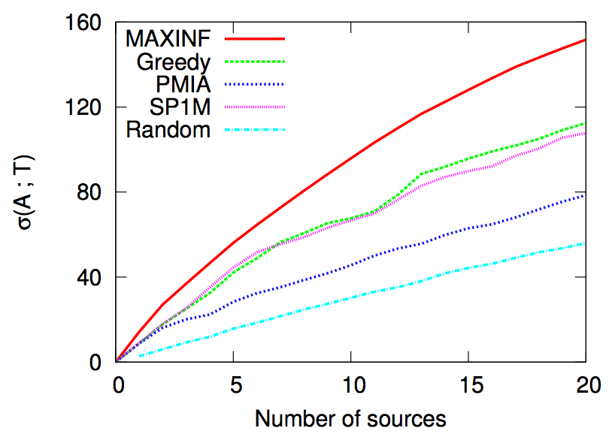
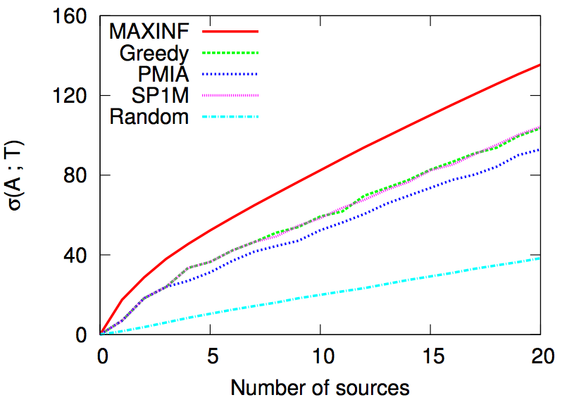
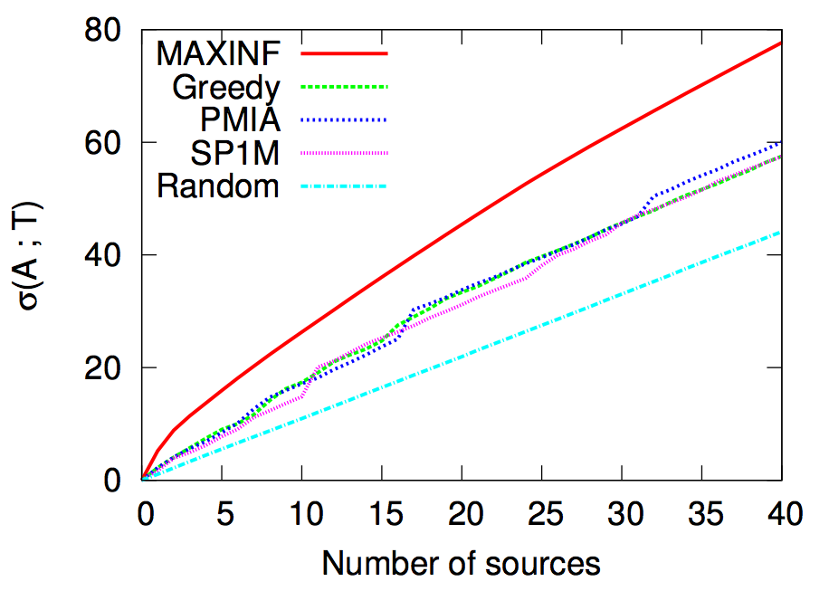
Influence maximization vs. # of sources
1024-node Forest Fire
1024-node Hierarchical Kronecker
512-node Random Kronecker
1000-node real network (MemeTracker)

Slide 10
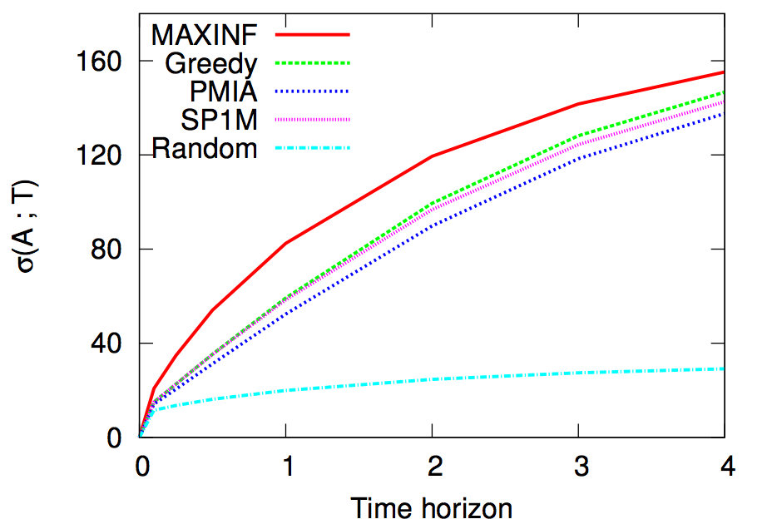
Influence vs. time horizon

Slide 11
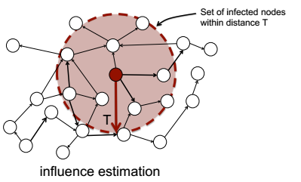
Influence estimation: exact vs. approx.
Approximate
Influence Estimation
Exact
Infection Probability
t_{n}
Can be exponential in network size, not scalable!
t_{A} = 0
t_{A} = 0
Source
Sink (node n)

Slide 12


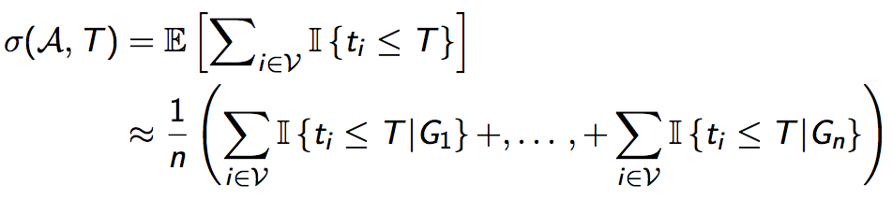
Naive neighborhood size estimation
Naive neighborhood size estimation using sampling:
1. Sample n sets of transmission times
2. Average counts across n samples

Slide 13
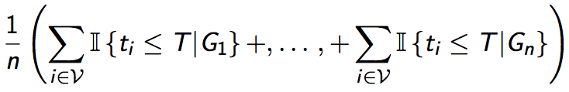
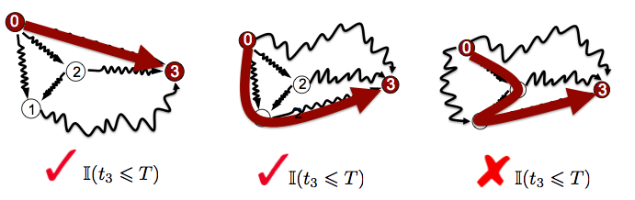
Naive neighborhood size estimation
Check whether length of
shortest path is ≤T
Quadratic in network
size (all pair of nodes),
not scalable!

Slide 14


Neighborhood vs. P(ti ≤ T)
It is difficult to scale exact influence estimation to networks with million of nodes.
Key fact: No need to
calculate each P(t_{i} ≤ T)
separately.
We only care about neighborhood!

Slide 15
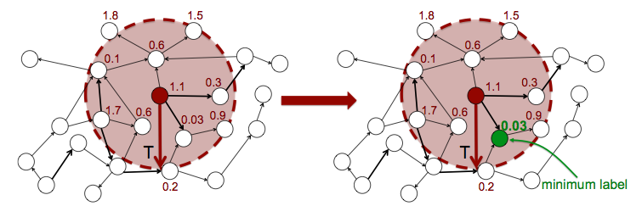



Cohen’s neighborhood estimation
Key fact: Given a set of n i.i.d. random variables X ~ e^{-x}, the minimum is distributed as X* ~ ne^{-nx}.
The estimator is unbiased and with variance O(1/(m-2))
1. Draw m sets of i.i.d. random labels
2. Find the minimum label at a distance ≤T by
using Cohen’s algorithm.
3. The neighborhood size is

Slide 16
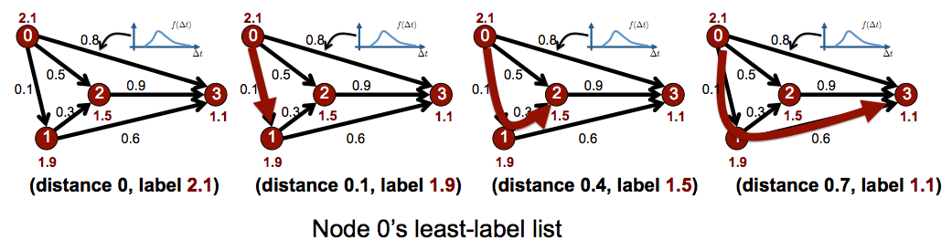
Cohen’s least label list
To find the minimum label at distance ≤T efficiently:
Cohen [‘97] invented a smart algorithm to generate
a label-list structure per node:
Increasing distance, decreasing label

Slide 17

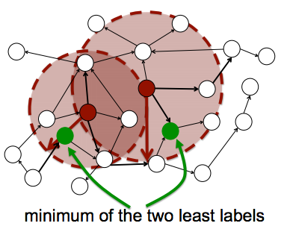
Multiple sources
Multiple sources:

Slide 18
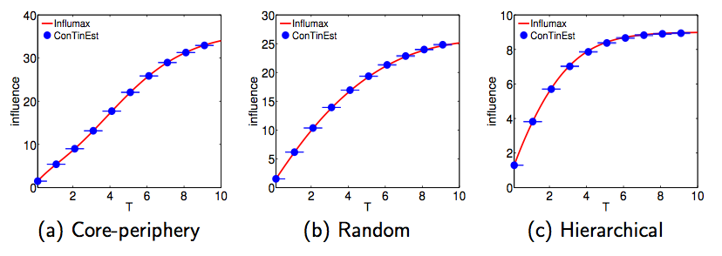
How good is the approximation?
Not only theoretical guarantees, but it also works well in practice.
Accuracy does not depend on the network structure

Slide 19
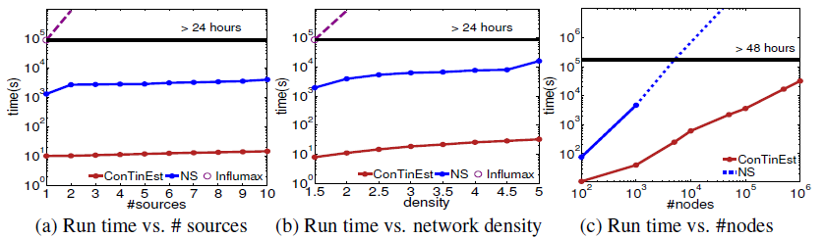
How scalable is the algorithm?
Small networks
  128 nodes, 320 edges
1 million nodes
Readily scale up to realistic networks with millions of nodes

Slide 20
Outline
  Influence Maximization
Exact & Approx. Estimation
Approx. Maximization
  Source Localization
Maximum likelihood
Estimation
  Activity Shaping
Beyond Influence Max
Convex Opt. Framework

Slide 21


Incomplete propagation traces
It is difficult to track every mention of a specific piece
of information
Especially in
real time!
Can we automatically find who was the first person posting
a piece of information?

Slide 22
The source identification problem
Information propagates on a directed network creating cascades:
τ_{ji} ~ f(τ_{ji} ; α_{ji})
Cascade 1
t_{j}
t_{i}
Can we identify the source from the network and a partial observation
of the cascade?
Source
We do not observed all infected nodes in a cascade,
only a few of them.

Slide 23
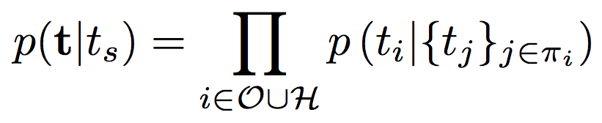

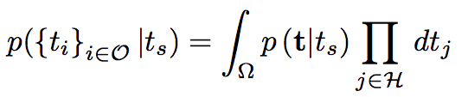
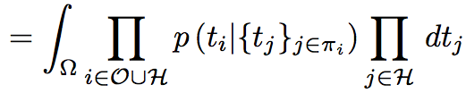


Likelihood of a cascade
The likelihood of a cascade factorizes as
Cascade
t_{s}
t_{k}
t_{l}
t_{i}
Time of infection of the source
If we only observe a subset of infected nodes :
Difficult high-dimensional integration problem
Marginalization over hidden nodes on

Slide 24
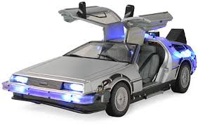

Framework for source identification
Stage 1
Infer diffusion model parameters from historical cascade data
Stage 2
Given the diffusion model & incomplete
cascade (or cascades), identify the source:
Difficult high-dimensional integration problem
Non-convex maximization

Slide 25




Importance Sampling Scheme
First, we introduce auxiliary distribution:
It will simplify computations!
Auxiliary distribution
Second, we introduce proposal distribution:
We will sample
from this distribution!
Proposal distribution

Slide 26
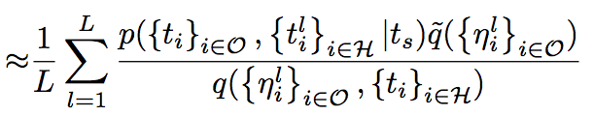

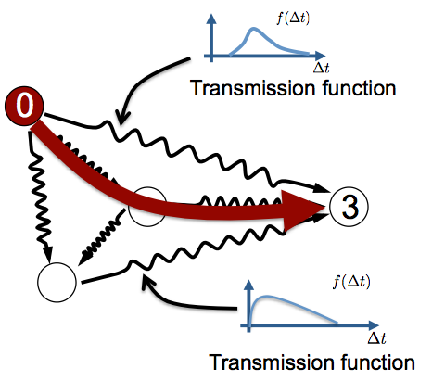

Choice of auxiliary & proposal distribution
Proposal distribution:
sample from the diffusion model
as if there were no observations
with node as source
Auxiliary distribution:
sample from the diffusion model
as if there were no observations
with the hidden nodes as sources

Slide 27

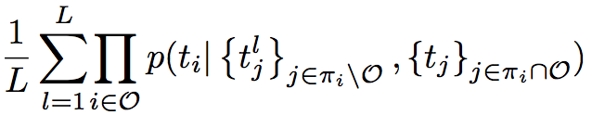
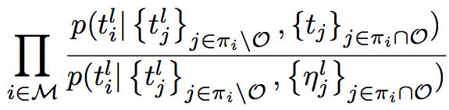
Why those distributions?
1. We can sample easily from the proposal distribution and has good convergence properties in practice
2. The auxiliary distribution allows us to cancel out many terms
Observed times
Sampled times
Likelihood of observed nodes
Likelihood ratio of hidden nodes with observed nodes as parents

Slide 28

Maximize objective function
Piece-wise continuous
function on t_{s}
Key idea: each piece corresponds to a different
feasible (temporally plausible) parent-child
configuration:
1. We can find all change points efficiently
2. One dimensional line-search for each piece
2a. More efficiently for exponential transmission functions

Slide 29
Synthetic data experiments: setup
  1. Generate network structure (Kronecker/Forest Fire)
  2. Assign edge transmission rates uniformly at random
  3. Simulate cascades from different random sources and
  record large cascades
  4. Run our method to infer the source of large cascades
  from partial observations (typically, 10%)

Slide 30
A toy example
Hierarchical Kronecker Network (64 nodes)
As more cascades are observed, the likelihood of the true source beats other nodes’ likelihoods.

Slide 31
Success Probability vs Number of Cascades
Erdos-Renyi Random Network (256 nodes)
Cascades longer than 40 nodes (10% observed)
Our method (blue) clearly beats competing methods

Slide 32
Success Probability vs Number of Cascades
Core-Periphery Kronecker Graph (256 nodes)
Cascades longer than 40 nodes (10% observed)
difficult to distinguish among nodes in the core

Slide 33
Success Probability vs % Observed Infections
Core-Periphery Kronecker Graph (256 nodes)
Cascades longer than 100 nodes
The more infections we observe, the easier it becomes

Slide 34
Success Probability vs Number of Samples
Hierarchical Kronecker Graph (256 nodes)
Cascades longer than 40 nodes (10% observed)
Success probability flattens with the number of samples

Slide 35
Real data experiments: setup
  1. Memes (“lipstick on a pig”) mentioned by 1,700 popular
  media sites & blogs for different topics [WSDM ‘13]
  2. Infer diffusion network for each topic from memes
  using a network inference method
  3. We extract large (meme) cascades for each topic,
  here large means >27 nodes
  4. Run our method to infer the source of large cascades
  from partial observations (typically, 10%)
Notes:
15 sources, each at least with 10 long cascades

Slide 36
Real Data: Success Probability vs Number of Cascades
Source identification in
real networks is a very
difficult problem!
Our method needs >7 cascades to (sometimes) find the source
Competing methods fail completely

Slide 37
Outline
  Influence Maximization
Exact & Approx. Estimation
Approx. Maximization
  Source Localization
Maximum likelihood
Estimation
  Activity Shaping
Beyond Influence Max
Convex Opt. Framework

Slide 38

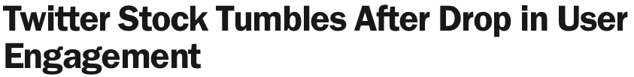


Activity shaping
Can we steer users’ activity
in a social network?
Why this goal?

Slide 39
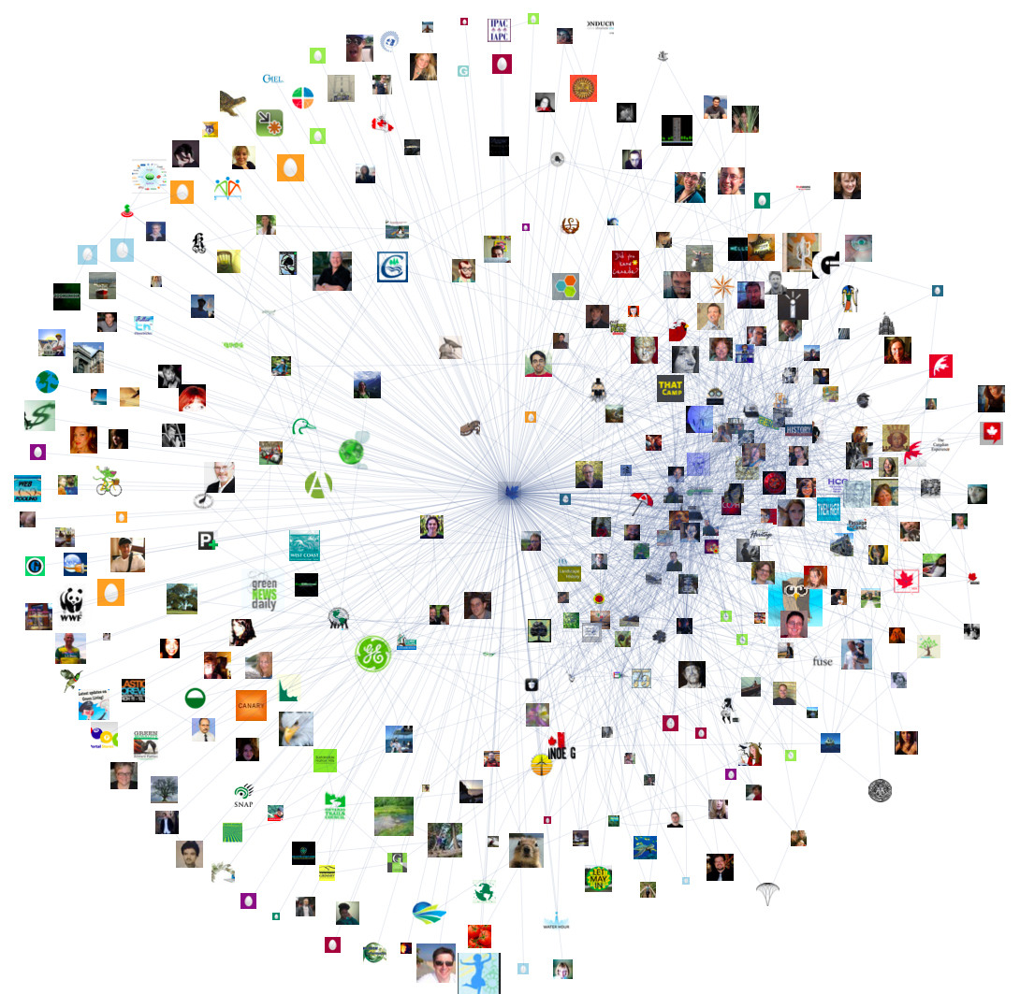








Activity shaping… is this new?
Related to
Influence Maximization Problem
Kempe et al. KDD’03 and many others
Influence maximization: simple
but far from real social activity
Activity shaping: more challenging (at first)
but close to real social activity
Influence
Maximization
Fixed incentive
One time the same piece of information
It is only about maximizing adoption
Activity
Shaping
Variable incentive
Multiple times multiple pieces,
recurrent!
Many different activity shaping tasks

Slide 40


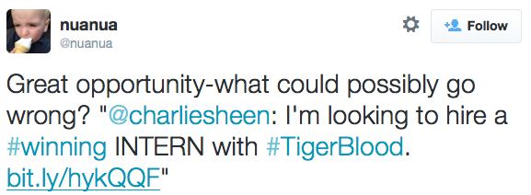
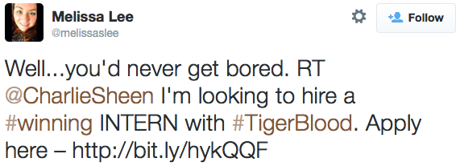
Exogenous vs endogenous activity
Exogenous activity
Users’ actions due to
drives external to the
network
Endogenous activity
Users’ responses to other users’ actions in the network
.
..

Slide 41
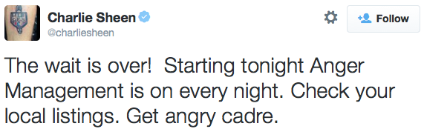
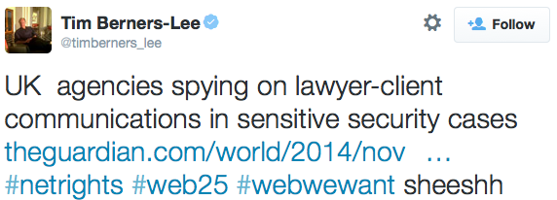
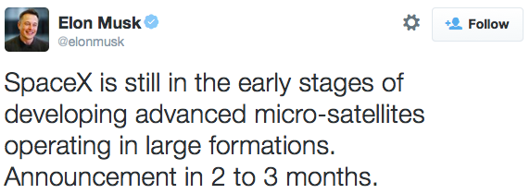
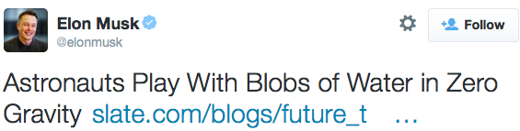
Activity shaping… how?
Incentivize
a few users to produce a given level
of overall users’ activity
Exogenous
activity
Endogenous
activity

Slide 42


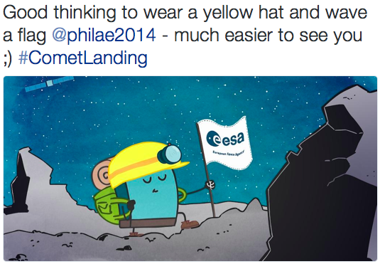
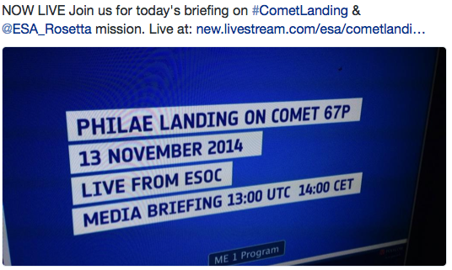

Endogenous & exogenous intensity
Overall activity
(events / day)
Exogenous
activity
Endogenous activity
0.54 tweets/hour
(13/11/2014)
0.08 tweets/hour
(13/11/2014)
0.62 tweets/hour
(13/11/2014)
.
..
.
..

Slide 43

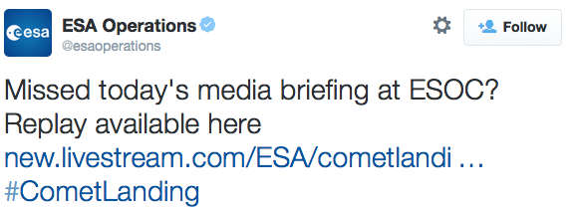


Exogenous intensity: Hawkes
Non-negative kernel (memory)
Endogenous activity
Influence of neighbor u_{i} on user u
Previous event by a neighboor
1:55 PM
13 Nov
2:54 PM
13 Nov
3:50 PM
13 Nov

Slide 44
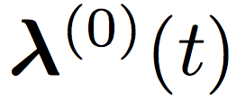

Activity shaping… what is it?
Activity Shaping:
Find exogenous activity
that results in a desired average
overall activity at a given time:
Average with respect to
the history of
events up to t!

Slide 45
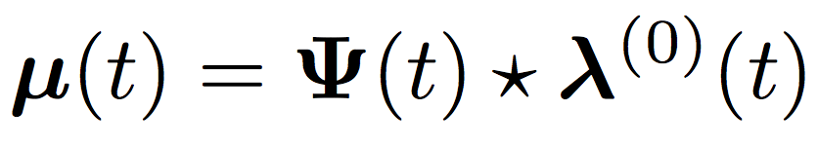

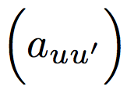
Exogenous intensity & average overall intensity
How do they relate?
Convolution
Surprisingly…
linearly:
matrix that
depends on
and
non negative
kernel
influence
matrix

Slide 46


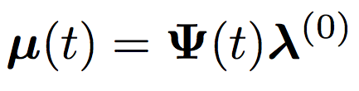
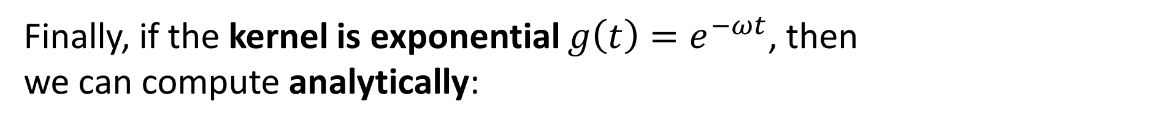
Exact Relation
Finally, if the kernel is exponential ${g\left(t\right)=e}^{−ωt}$, then we can compute analytically:
Matrix
exponentials
Corollary
exogenous intensity
is constant

Slide 47
Does it really work in practice?

Slide 48
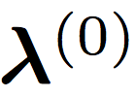
Activity shaping optimization framework
Once we know that
we can find to satisfy many different goals:
Activity Shaping Problem
We can solve this problem efficiently for a large
family of utilities!
Utility (Goal)
Budget
Cost for incentivizing

Slide 49

Capped activity maximization (CAM)
If our goal is maximizing the overall number of events across a social network:
Max feasible
activity per user

Slide 50



Minimax activity shaping (MMASH)
If our goal is make the user with the minimum activity as active as possible:

Slide 51

Least-squares activity shaping (LSASH)
If our goal is to achieve a pre-specified level of activity for each user or group of users:

Slide 52

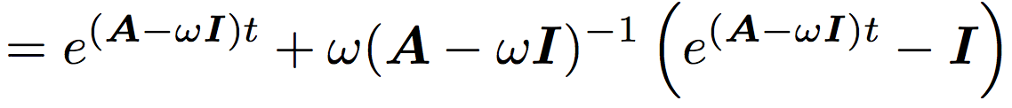
Solving the activity shaping problem
For any activity shaping problem, we need to:
1. Compute:
Can be cubic in the network size
Large matrix
exponential
Inverse of
a large matrix
Large matrix
exponential
2. Solve the convex problem:
Standard: projected gradient descent

Slide 53
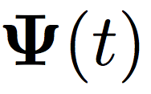
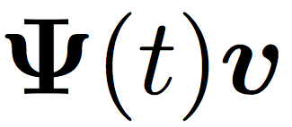
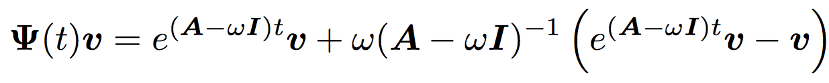

Computing the average overall intensity
The explicit computation of becomes quickly intractable for large networks (large sparse A)
Key property: we don’t need but
1. [Al-Mohy et al., 2011]
2. Sparse linear systems of equations [GMRES method]:

Slide 54




URL shortenings in Twitter
Product for which we can track their users’
usage pattern in Twitter.
URL shortening services
  bit.ly
  tinyurl
  is.gd
  doiop

Slide 55
Evaluation of our model on real data
Two twitter networks with 2K users and 50K users who used URL shortenings over a 8 month period.
Fit model(s) on
different time periods
Run many different
activity shaping tasks
complex held-out
evaluation
(close to intervention)
Evaluate theoretical
& simulated results
vs baselines

Slide 56


Complex held-out evaluation
We divide the 8-month period into 50 contiguous 5-day sub periods:
…
…
Fit model
Fit model
Fit model
Fit model and
solve activity shaping
We sort distances
(i) between exogeneous rates
(ii) between overall activity
Compute rank
correlation

Slide 57
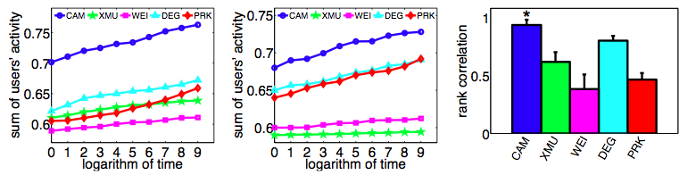
Capped activity maximization: results
For 2K users:
Held-out evaluation
Theoretical
Simulation
+10% more events
than 2nd best
+34,000 more events per month than 2nd best

Slide 58
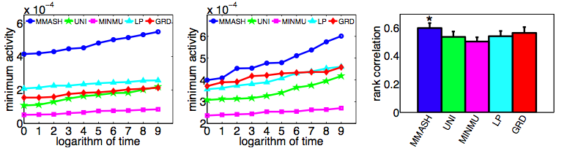
Minimax activity shaping: results
For 2K users:
Held-out evaluation
Theoretical
Simulation
less active user 2x more events
than 2nd best
less active user +4.32 more events per month than 2nd best

Slide 59
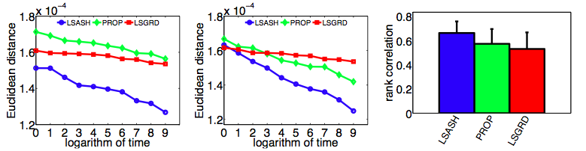
Least-square activity shaping: results
For 2K users:
Theoretical
Simulation
Held-out evaluation
We are always closer to target level than baselines.

Slide 60
Scalability of our algorithm
How does our efficient algorithm compare to a naive implementation of activity shaping?
Up to 10k users
Up to 50k users
Our algorithm is several order of magnitude faster!

Slide 61
What is all about?
Stochastic processes
over a
large networks
Part I: Models
Part II: Learning Methods
  Modeling Information Diffusion
  Influence Maximization
Submodular Optimization
Scalable Algorithm
Basic Cascade Model
Cascades as Point Processes
  Source Localization
  Modeling Social
  Activity
Maximum likelihood
Estimation
  Activity Shaping
Beyond Cascades
Activity as Hawkes Processes
Beyond Influence Max
Convex Opt. Framework
Notes:
Outline of tutorial

Slide 62










Processes over networks
Economic Transactions
Disease Spread
Causes, Petitions & Non-Profit

Slide 63
Networks: tools and connections
Event-History
Analysis & Statistics
Computer
Systems
Machine Learning & Data Mining
Theory & Algorithms
Networks & Processes
Over Networks
Epidemiology
Social & Information Sciences
Decision
Theory
Biology
Economics
Physics
Notes:
Collaborators / logos.

Slide 64
Thanks!
more at:
learning.mpi-sws.org/kdd-2015-tutorial/

