Slide 1
Machine learning for
Dynamic Social Network Analysis
Applications: Control
Manuel Gomez Rodriguez
Max Planck Institute for Software Systems
IJCAI Tutorial, August 2017

Slide 2
Outline of the Seminar
Representation: Temporal Point processes
1. Intensity function
2. Basic building blocks
3. Superposition
4. Marks and SDEs with jumps
Applications: Models
1. Information propagation
2. Information reliability
3. Knowledge acquisition
Applications: Control
Next
1. Activity shaping
2. When-to-post
Slides/references: learning.mpi-sws.org/ijcai-2017-tutorial

Slide 3
Applications: Control
1. Activity shaping
2. When-to-post
Notes:
Outline of tutorial

Slide 4

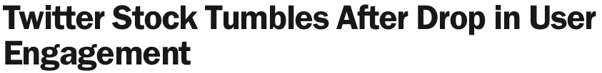


Activity shaping
Can we steer users’ activity in a social network in general?
Why this goal?

Slide 5
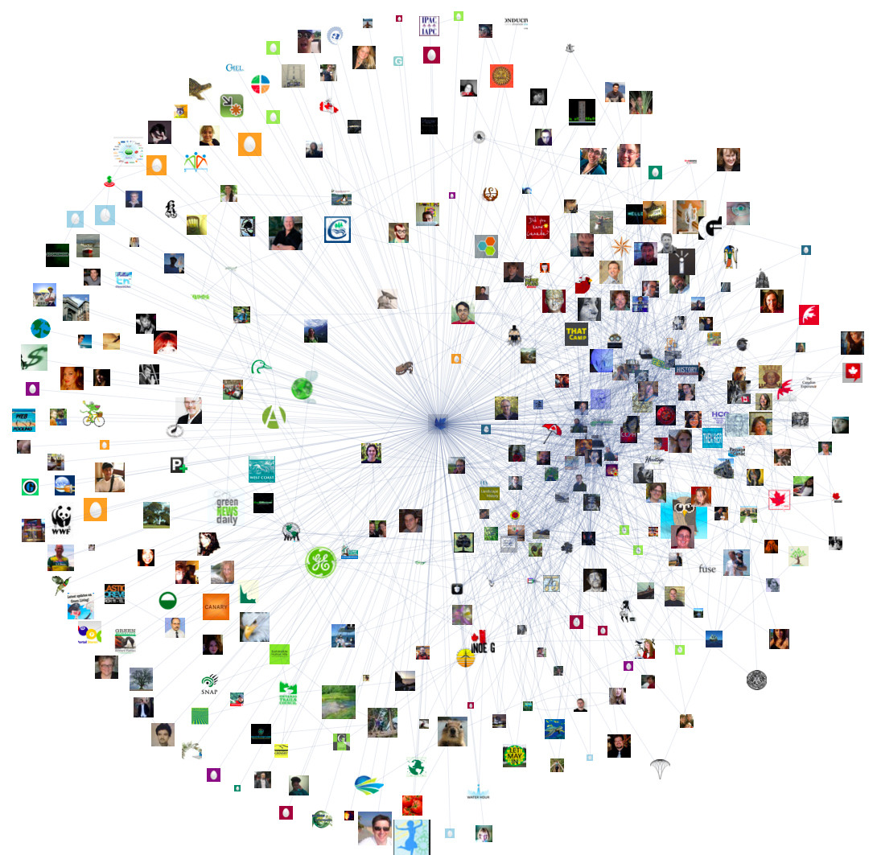








Activity shaping vs influence maximization
Related to
Influence Maximization Problem
Activity shaping is a generalization
of influence maximization
Influence
Maximization
Fixed incentive
One time the same piece of information
It is only about maximizing adoption
Activity
Shaping
Variable incentive
Multiple times multiple pieces,
recurrent!
Many different activity shaping tasks

Slide 6

Event representation
We represent messages using nonterminating temporal point processes:
N₁(t)
Recurrent event:
N₂(t)
N₃(t)
User
Time
N₄(t)
N₅(t)
[Farajtabar et al., NIPS 2014]

Slide 7

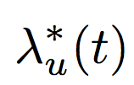
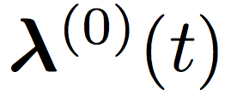



Events intensity
N₁(t)
N₂(t)
N₃(t)
N₄(t)
N₅(t)
Exogenous activity
Memory
Hawkes process
User’s
intensity
Messages on her
own initiative
Influence from
user u_{i} on user u
7
[Farajtabar et al., NIPS 2014]

Slide 8
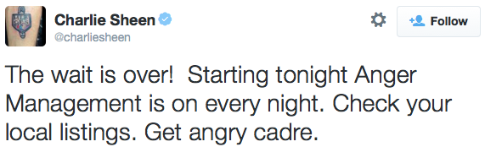
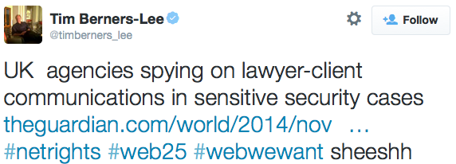
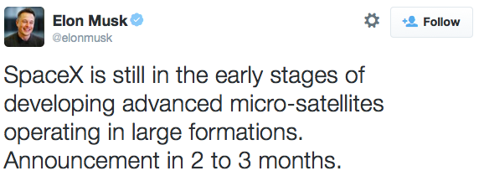
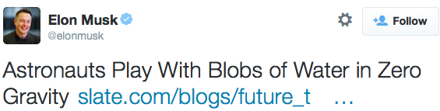
Activity shaping… how?
Incentivize
a few users to produce a given level
of overall users’ activity
Exogenous
activity
Endogenous
activity

Slide 9

Activity shaping… what is it?
Activity Shaping:
Find exogenous activity
that results in a desired average
overall activity at a given time:
Average with respect to
the history of
events up to t!
[Farajtabar et al., NIPS 2014]

Slide 10
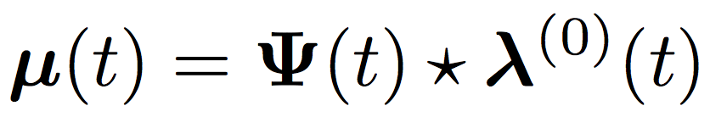

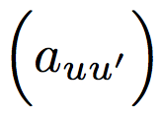
Exogenous intensity & average overall intensity
How do they relate?
Convolution
Surprisingly…
linearly:
matrix that
depends on
and
non negative
kernel
influence
matrix
[Farajtabar et al., NIPS 2014]

Slide 11


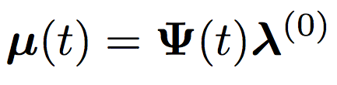
Exact Relation
If the memory g(t) is exponential:
Matrix
exponentials
Corollary
exogenous intensity
is constant
[Farajtabar et al., NIPS 2014]

Slide 12
Does it really work in practice?
[Farajtabar et al., NIPS 2014]

Slide 13
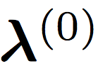
Activity shaping optimization framework
Once we know that
we can find to satisfy many different goals:
Activity Shaping Problem
We can solve this problem efficiently for a large
family of utilities!
Utility (Goal)
Budget
Cost for incentivizing
[Farajtabar et al., NIPS 2014]

Slide 14

Capped activity maximization (CAM)
If our goal is maximizing the overall number of events across a social network:
Max feasible
activity per user
[Farajtabar et al., NIPS 2014]

Slide 15



Minimax activity shaping (MMASH)
If our goal is make the user with the minimum activity as active as possible:
[Farajtabar et al., NIPS 2014]

Slide 16

Least-squares activity shaping (LSASH)
If our goal is to achieve a pre-specified level of activity for each user or group of users:
[Farajtabar et al., NIPS 2014]

Slide 17
Capped activity maximization: results
+34,000 more events per month than best heuristic for 2,000 Twitter users
+10% more events
than best heuristic
[Farajtabar et al., NIPS 2014]

Slide 18
Applications: Control
1. Activity shaping
2. When-to-post
Notes:
Outline of tutorial

Slide 19

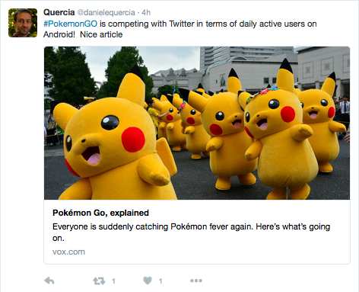


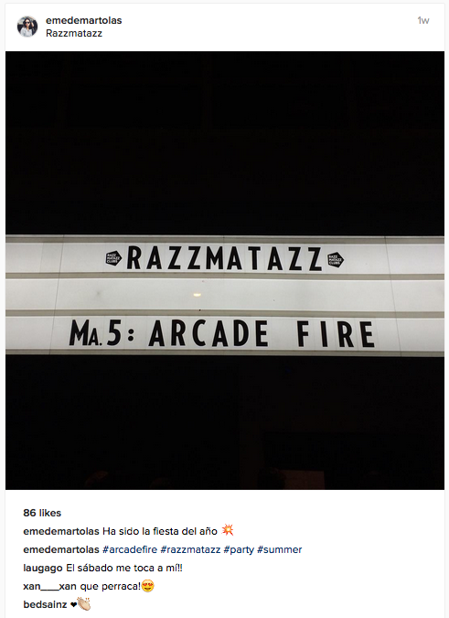


Social media as a broadcasting platform
Everybody can build, reach and broadcast information to
their own audience
Broadcasted content
Audience
reaction

Slide 20
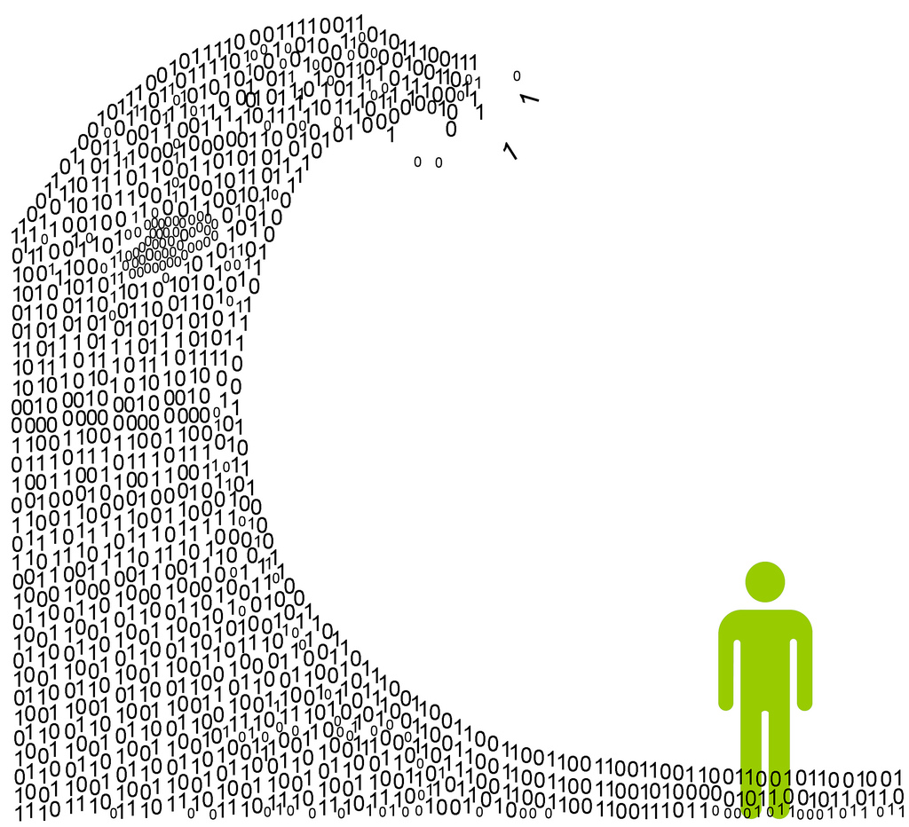
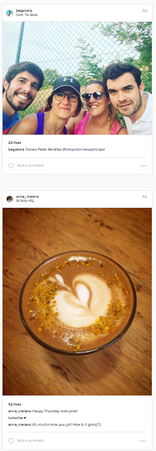


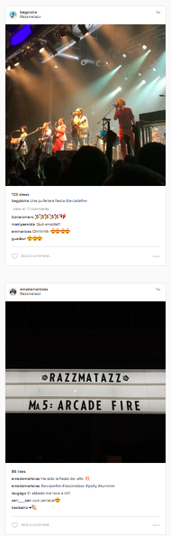


Attention is scarce
Social media users follow many broadcasters
Twitter feed
Instagram feed
Older posts
Older posts

Slide 21


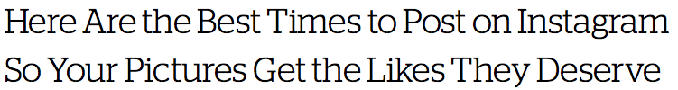

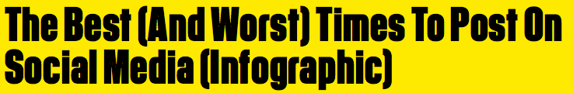

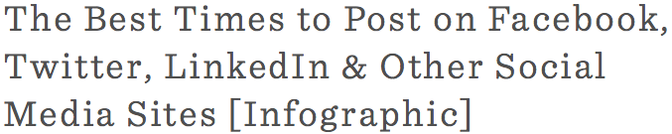

What are the best times to post?
Can we design an algorithm that tell us when to post to achieve high visibility?

Slide 22







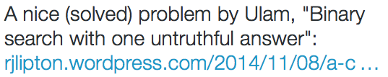

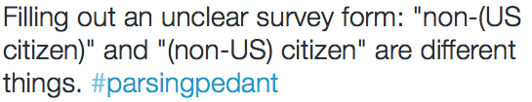

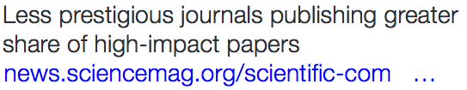

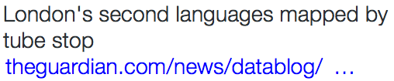
Representation of broadcasters and feeds
Broadcasters’ posts as
a counting process N(t)
Users’ feeds as sum of
counting processes M(t)
N₁(t)
M₁(t)
t
N₂(t)
M(t) = A^{T} N(t)
t
…
t
M_{n}(t)
…
N_{n}(t)
t

Slide 23









Broadcasting and feeds intensities
N(t)
M(t)
t
t
Broadcaster
intensity function
(tweets / hour)
Feed intensity function
(tweets / hour)
Given a broadcaster i and her followers
Feed due to other broadcasters

Slide 24
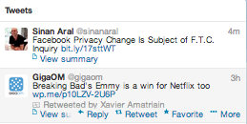
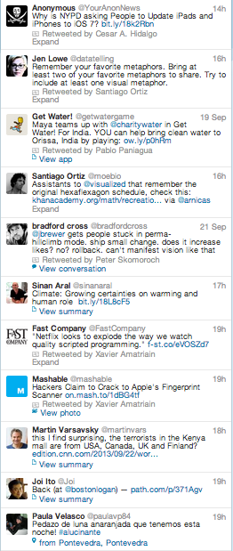
Definition of visibility function
Visibility of broadcaster i at follower j
M(t)
Position of the highest ranked tweet by broadcaster i in follower j’s wall
r_{ij}(t) = 0
r_{ij}(t’) = 4
r_{ij}(t’’) = 0
In general, the visibility depends on the feed ranking mechanism!
t
Feed
ranking
….
.
Older tweets
Ranked stories
Post by broadcaster u
Post by other broadcasters

Slide 25
Optimal control of temporal point processes
Formulate the when-to-post problem as a novel stochastic optimal control problem
(of independent interest)
Visibility and feed
dynamics
Optimizing visibility
Experiments
System of stochastic equations with jumps
Optimal control of
jumps
Twitter

Slide 26
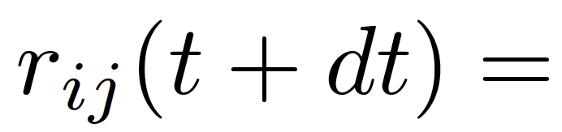
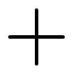

Visibility dynamics in a FIFO feed (I)
New tweets
Reverse chronological order
M(t)
Older tweets
Rank at t+dt
Other broadcasters
post a story and
broadcaster i does
not post
Broadcaster i
posts a story and
other broadcasters do not post
Nobody posts
a story
r_{ij}(t)=2
r_{ij}(t+dt) = 3
r_{ij}(t)=2
r_{ij}(t+dt) =0
r_{ij}(t)=2
r_{ij}(t+dt)=2
Follower’s wall
…
…
…
…
…
…
[Zarezade et al., WSDM 2017]

Slide 27
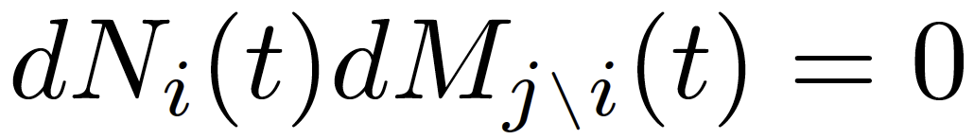
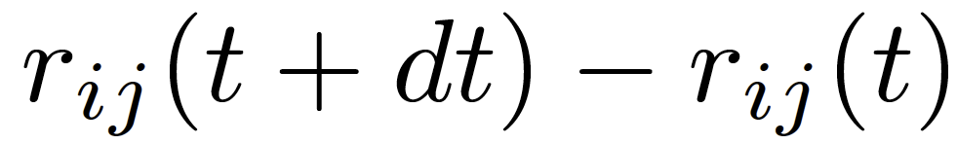
Visibility dynamics in a FIFO feed (II)
Zero-one law
Stochastic
differential equation (SDE) with jumps
Broadcaster i
posts a story
Other broadcasters posts a story
Our Goal:
Optimize r_{ij}(t) over time, so that it is small, by controlling dN_{i}(t) through the intensity μ_{i}(t)
[Zarezade et al., WSDM 2017]

Slide 28
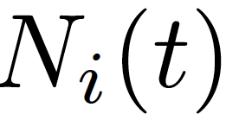
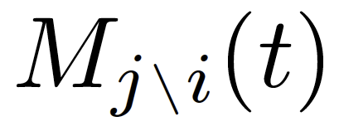


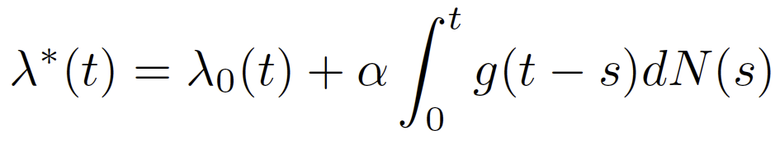
Feed dynamics
We consider a
general intensity:
(e.g. Hawkes,
inhomogeneous Poisson)
Deterministic
arbitrary intensity
Stochastic
self-excitation
Jump stochastic
differential equation (SDE)
[Zarezade et al., WSDM 2017]

Slide 29
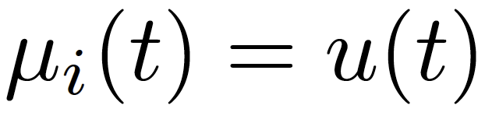
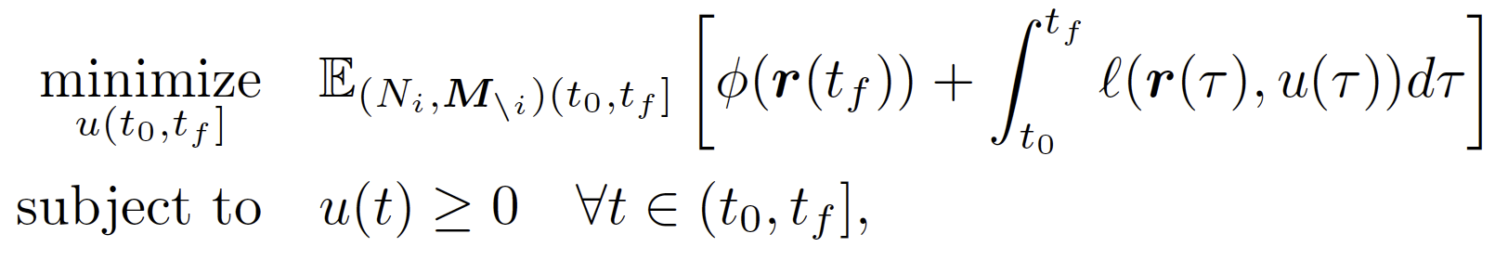
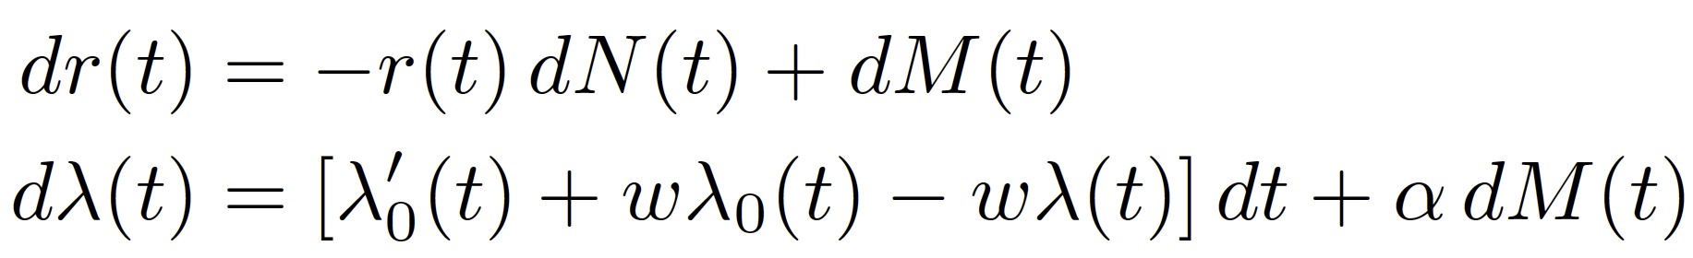
The when-to-post problem
…
Terminal penalty
Nondecreasing loss
Optimization
problem
Dynamics defined by Jump SDEs
[Zarezade et al., WSDM 2017]

Slide 30
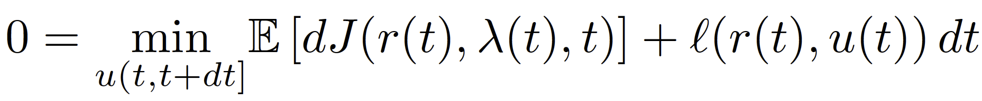
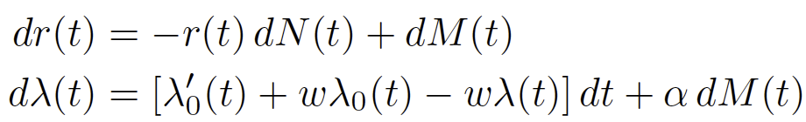
Bellman’s Principle of Optimality
Lemma. The optimal cost-to-go satisfies Bellman’s Principle of Optimality
t
Hamilton-Jacobi-Bellman (HJB)
equation
Partial differential
equation in J
(with respect to r, λ and t)
[Zarezade et al., WSDM 2017]

Slide 31
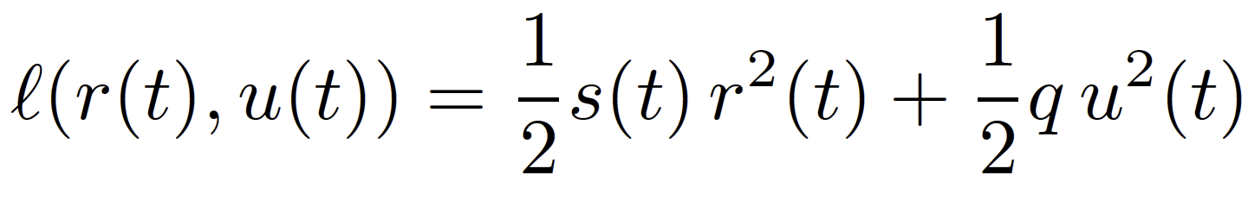

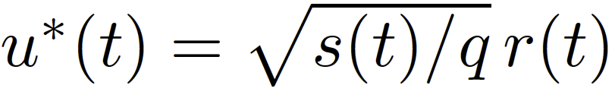

Solving the HJB equation
Consider a quadratic loss
Favors some periods of times
(e.g., times in which the follower is online)
Trade-offs visibility and number
of broadcasted posts
We propose and then show that the optimal intensity is:
It only depends on the
current visibility!
[Zarezade et al., WSDM 2017]

Slide 32


The RedQueen algorithm
Consider s(t) = s
u*(t) = (s/q)^{1/2} r(t)
How do we sample the next time?
r(t)
Superposition principle
t₁
t₂
t₃
t₄
t
Δ_{i} exp( (s/q)^{1/2} )
t₁ + Δ₁
t₂ + Δ₂
t₃ + Δ₃
t₄ + Δ₄
min_{i} t_{i} + Δ_{i}
It only requires sampling M(t_{f}) times!
[Zarezade et al., WSDM 2017]

Slide 33
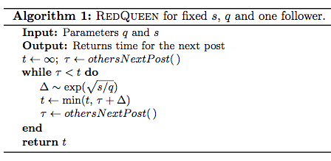
The RedQueen algorithm
RedQueen can be implemented in a few lines of code!
[Zarezade et al., WSDM 2017]

Slide 34
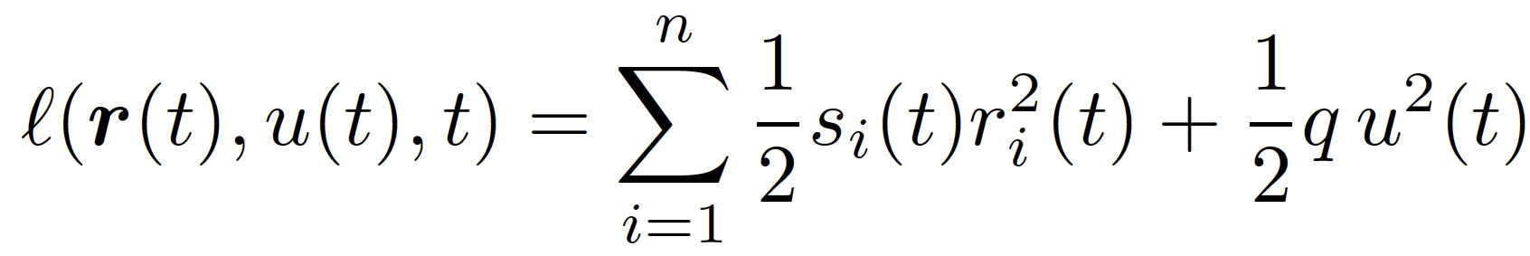
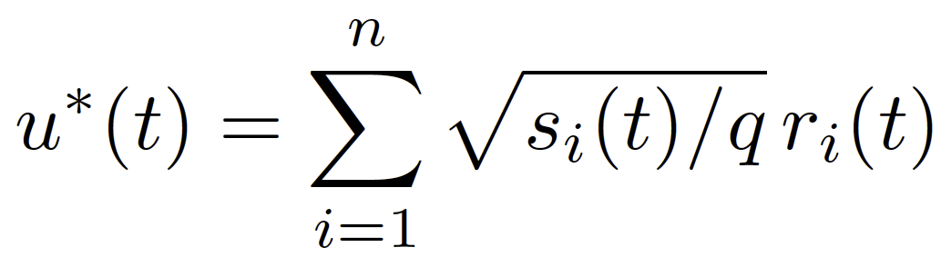
When-to-post for multiple followers
Consider n followers and a quadratic loss:
We can easily adapt the efficient sampling algorithm to multiple followers!
Favors some periods of times
(e.g., times in which the follower is online)
Trade-offs visibility and number
of broadcasted posts
Then, we can show that the optimal intensity is:
It only depends on the
current visibilities!
[Zarezade et al., WSDM 2017]

Slide 35
Novelty in the problem formulation
The problem formulation is unique in two key technical aspects:
I. The control signal is a conditional intensity
Previous work: time-varying real vector
II. The jumps are doubly stochastic
Previous work: memory-less jumps
[Zarezade et al., WSDM 2017]

Slide 36
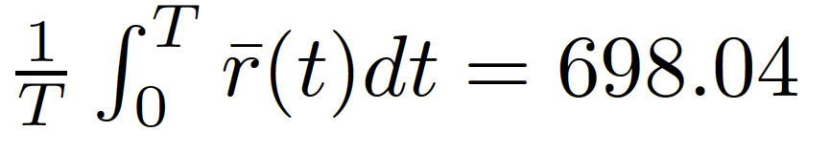
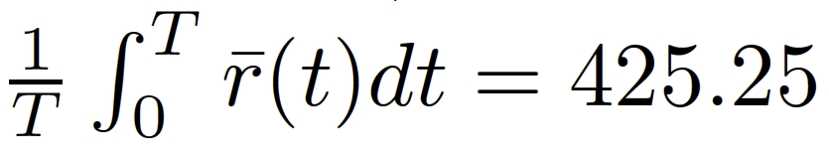
Case study: one broadcaster
Significance:
followers’ retweets
per weekday
Broadcaster’s
posts
Average position
over time
True posts
RedQueen
40% lower!
[Zarezade et al., WSDM 2017]

Slide 37
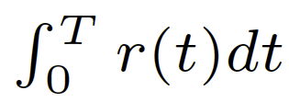
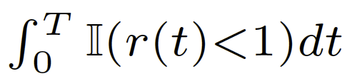
Evaluation metrics
Position over time
Time at the top
Post by broadcaster
Post by other broadcasters
r(t₁) = 0
r(t₂) = 1
r(t₃) = 0
r(t₄) = 1
r(t₅) = 2
r(t₆) = 0
Follower’s wall
…
…
…
…
…
…
Position over time =
0x(t₂ – t₁)
+ 1x(t₃ – t₂)
+ 0x(t₄ – t₃)
+ 1x(t₅ – t₄)
+ 2x(t₆ – t₅)
Time at the top =
(t₂ – t₁)
+ 0
+ (t₄ – t₃)
+ 0
+ 0
[Zarezade et al., WSDM 2017]

Slide 38
Position over time
broadcasters’
true posts
average across
users
Better
It achieves (i) 0.28x lower average position, in average, than the broadcasters’ true posts and (ii) lower average position for 100% of the users.
[Zarezade et al., WSDM 2017]

Slide 39
Time at the top
average across
users
Better
broadcasters’
true posts
It achieves (i) 3.5x higher time at the top, in average, than the broadcasters’ true posts and (ii) higher time at the top for 99.1% of the users.
[Zarezade et al., WSDM 2017]

Slide 40
Representation: Temporal Point processes
1. Intensity function
2. Basic building blocks
3. Superposition
4. Marks and SDEs with jumps
Applications: Models
1. Information propagation
2. Information reliability
3. Knowledge acquisition
Applications: Control
1. Activity shaping
2. When-to-post
Slides/references: learning.mpi-sws.org/ijcai-2017-tutorial

